Slide 1
Azure Container Hackfest
Delivering modern cloud native applications with open source technologies on Azure

Slide 2


Who are we?
Jordan Nielsen
Microsoft
Cloud Solution Architect
Chris Weirderspan
Microsoft
Technology Solution Professional
Adam Barlow
Microsoft
Technology Solution Professional

Slide 3

Partners
Joe Maurer
Attunix
Account Executive
Bob Coulehan
NetApp
Azure Sales Director

Slide 4
Agenda
Time
Topic
8:30 – 9:00
Breakfast and get settled
9:00 – 9:30
Containers, Docker, Kubernetes Overview, Namespaces, Quotas
9:30 – 10:15
Azure Kubernetes Service Overview & Features
10:15 – 11:00
Hands on Lab 1
11:00 - 11:45
Azure Container Registry, ACR Build, Helm
11:45 – 1:00
HANDS-ON: Labs 2, 3
1:00 – 1:20
Azure Devops, CI/CD
1:15– 2:15
HANDS-ON: Labs 4
2:15 – 2:45
Networking, Monitoring and Logging
2:45 – 4:00
HANDS-ON: Labs 5, 6
4:00 – 4:45
Kubernetes Storage, Azure Container Instances

Slide 5
Virtualization versus containerization
Virtual machine
Application
Container
Application XYZ
Dependencies
App dependencies
Guest OS
VM
VM
VM
C
C
C
C
C
VM
VM
VM
Hypervisor 2
Docker Engine
Hypervisor 1
Host OS
Host OS
Hardware
Hardware
Hardware
Type 1
Type 2
Virtualization
Containerization

Slide 6
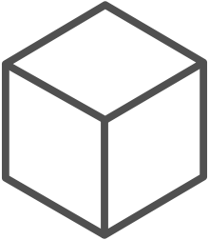
The container advantage
Fast iteration
Agile delivery
Immutability
Cost savings
Efficient deployment
Elastic bursting
For developers
For IT

Slide 7
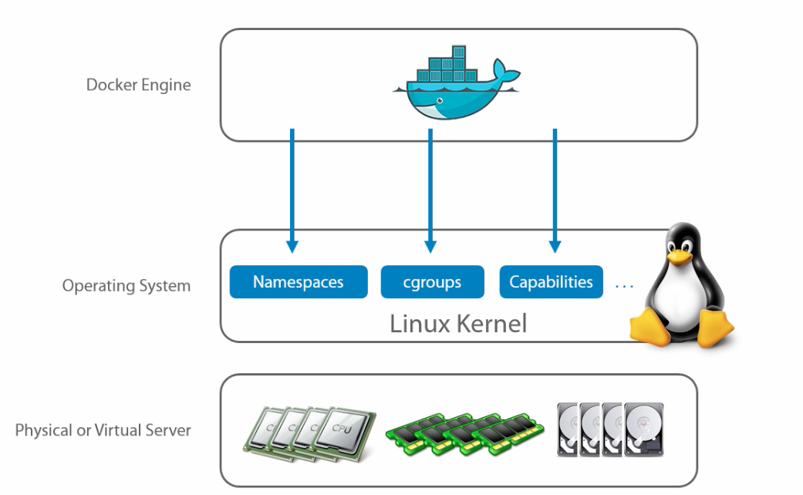
Docker makes it easy

Slide 8
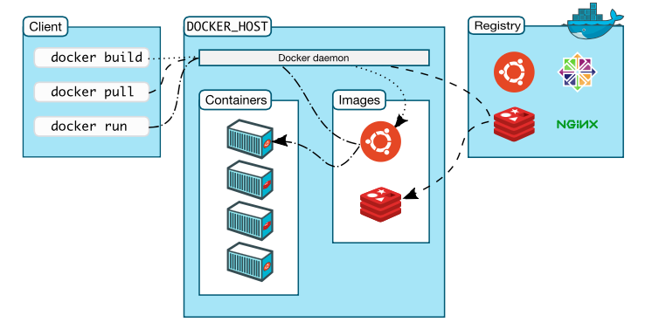
Docker Architecture

Slide 9



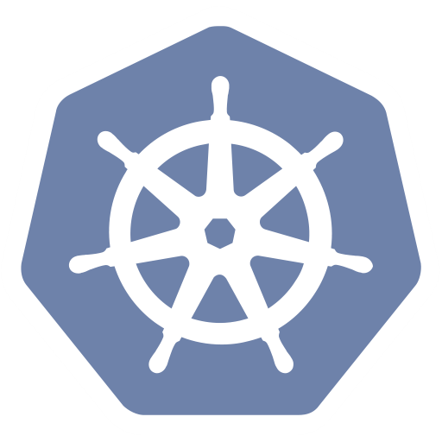
Container orchestration
Azure Container Registry
Open source community
Azure Kubernetes Service (AKS)
Release automation tools
Containers 101
Getting started
Azure container technology
Open Service Broker for Azure (OSBA)
Customer success stories
Container orchestration
Azure Container Instances (ACI)

Slide 10

Containers need management

Slide 11
The elements of orchestration
Scheduling
Affinity/anti-affinity
Health monitoring
Failover
Scaling
Networking
Service discovery
Coordinated app upgrades

Slide 12
Kubernetes: the de-facto orchestrator
Portable
Public, private, hybrid, multi-cloud
Extensible
Modular, pluggable, hookable, composable
Self-healing
Auto-placement, auto-restart, auto-replication, auto-scaling

Slide 13
Kubernetes Concepts

Slide 14
Kubernetes Architecture Components
api-server
etcd
master components
controller-manager
scheduler
* Azure Managed
kubelet
kube-proxy
node components
docker
dns

Slide 15


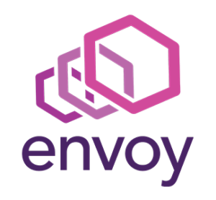

Pod

Slide 16
pod
pod
rating-api
rating-web
port
3000
port
8080
pod
rating-db
port
27017

Slide 17
Deployment
label
app=heroes-web , tier=web
image
azurecr.io/rating-web:v1
pod
heroes-web-1
port
8080
port
pod
heroes-web-2
port
8080
heroes-web

Slide 18
Deployment
label
app=heroes-web, tier=web
image
azurecr.io/rating-web:v1
pod
Service
heroes-web-1
port
8080
Heroes-web
pod
port
selector
app=heroes-web
heroes-web-2
port
8080:8080
port
8080
IP
10.0.2.20
heroes-web

Slide 19
Different clusters for dev, stage, prod
Typically you would have a namespace for team
You only have access to the resources in your namespace
You cannot view or modify resources in other teams namespaces
Node
Node
Pod
Pod
Pod
Pod
Namespace foo
…
Namespace bar
Namespace foo
…
Namespace bar
container
container
container
container

Slide 20
kubectl
(command-line tool)
Master
kubelet
Pod
Pod
…
Api Server
Scheduler
Node
kubelet
Node
kubelet
Pod
Pod
Pod
Pod
…
container
container
container
container

Slide 22
Azure container technology
Azure Container Registry
Open source community
Azure Kubernetes Service (AKS)
Release automation tools
Containers 101
Getting started
Azure container technology
Open Service Broker for Azure (OSBA)
Customer success stories
Container orchestration
Azure Container Instances (ACI)

Slide 23
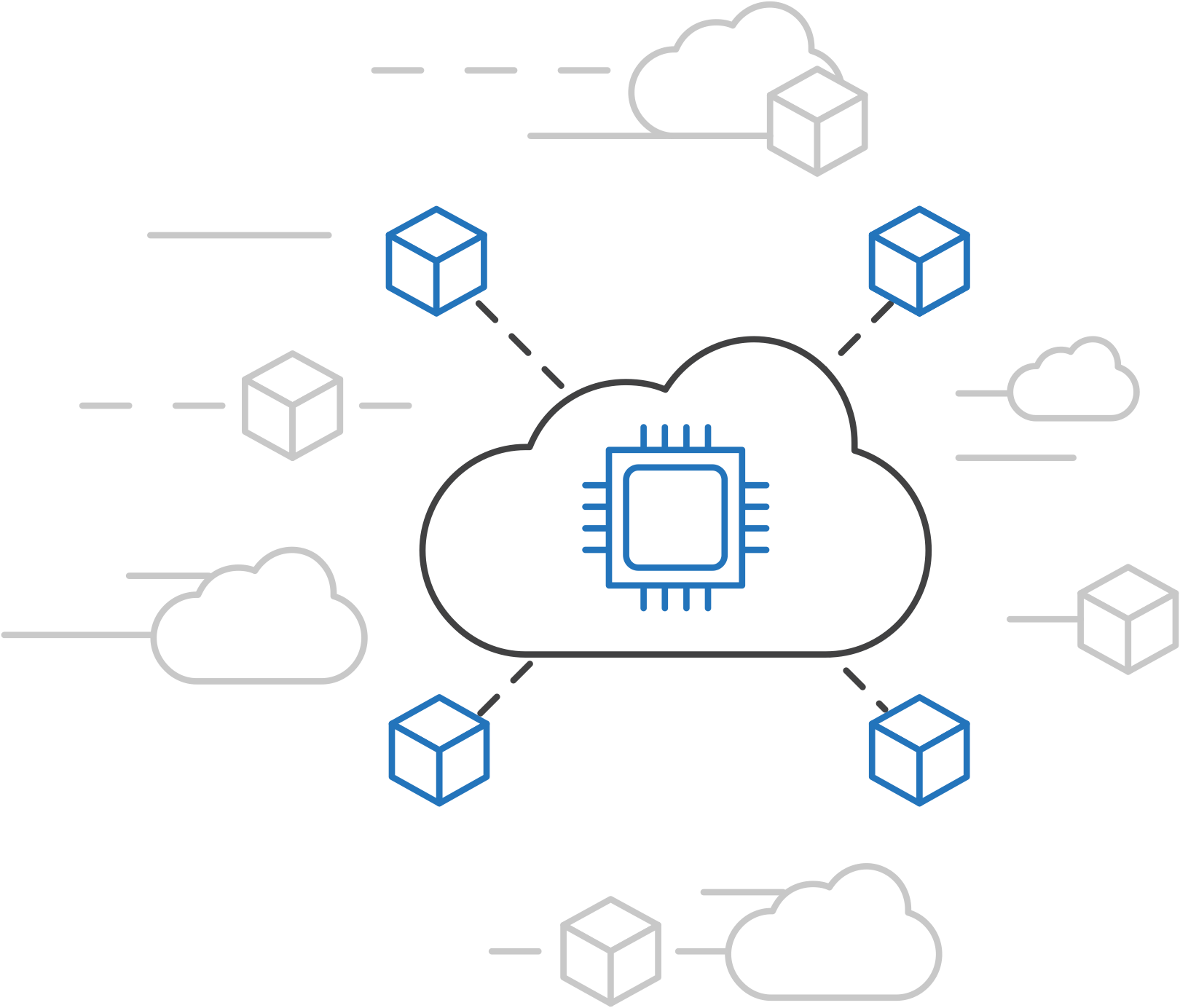
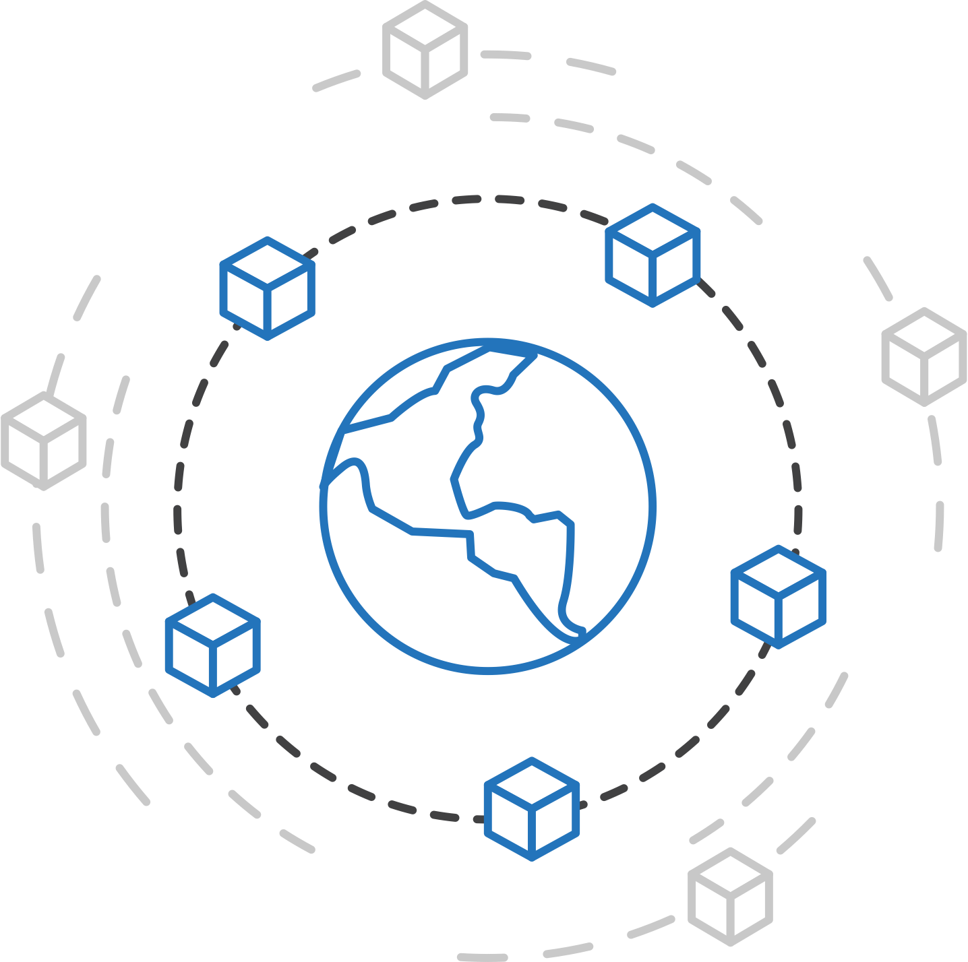
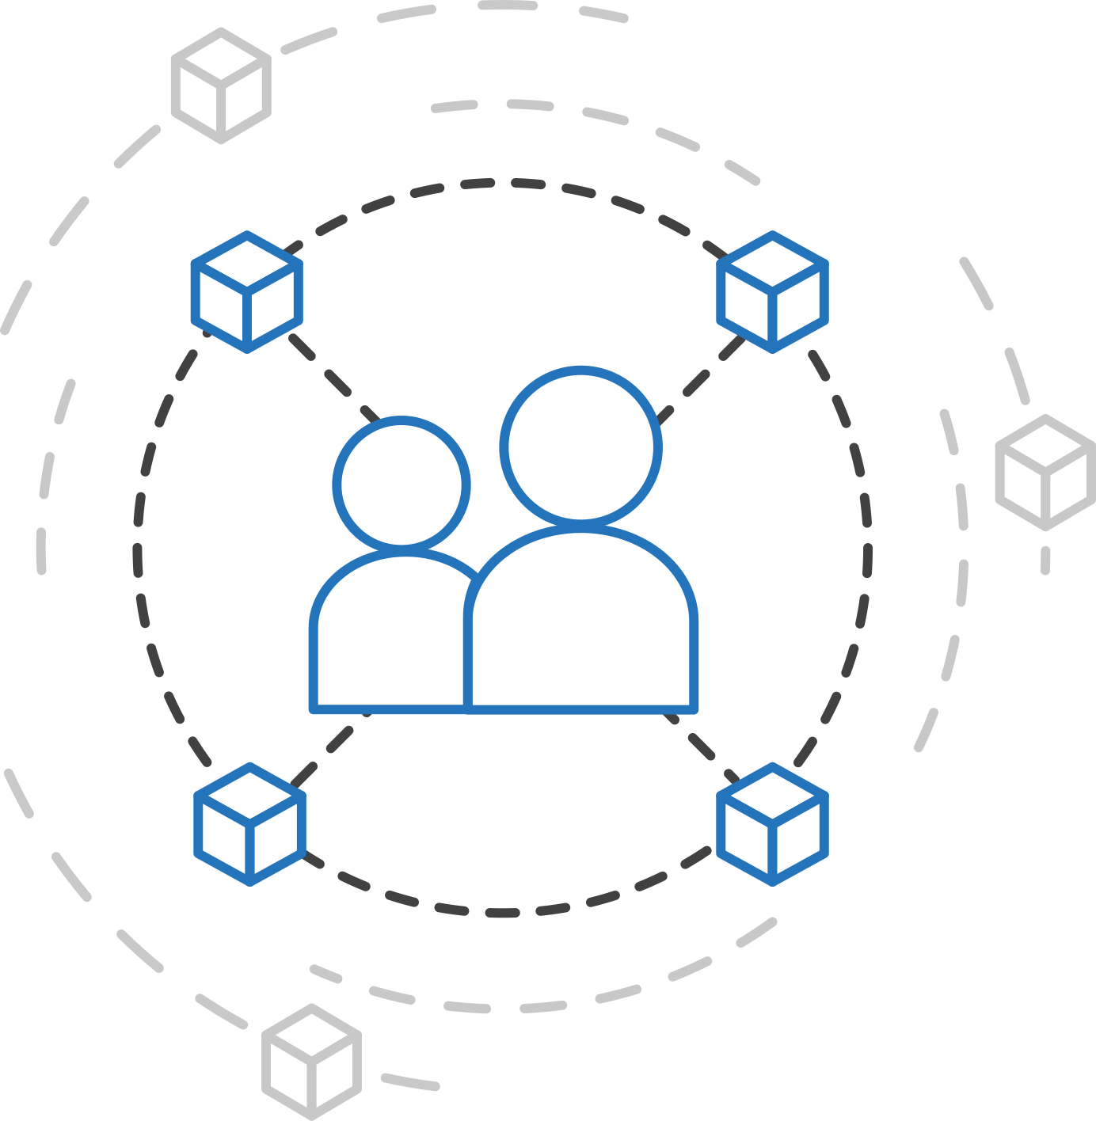
Azure container strategy
Embrace containers as ubiquitous
Support containers across the compute portfolio
Democratize container technology

Slide 24



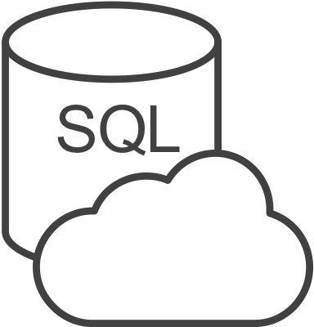



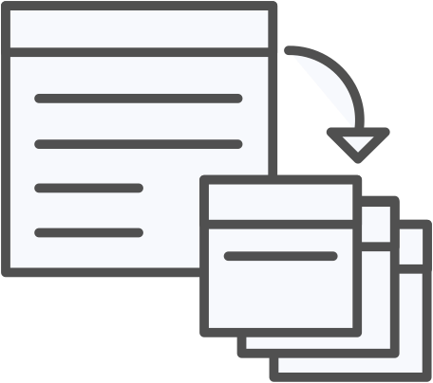


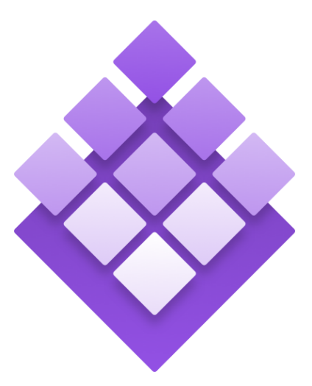
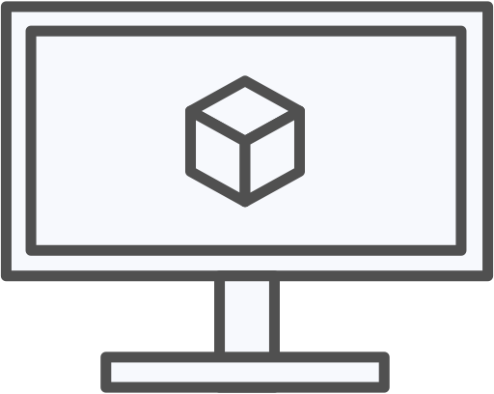
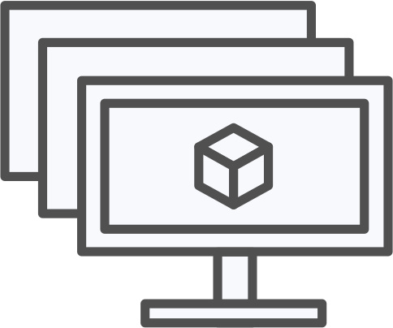
Azure container ecosystem
OSBA
App Service
Azure Container Registry (ACR)
Partner services
Azure services
PaaS
OpenShift
SQL Database
Azure Kubernetes Service (AKS)
Service Fabric
Batch
Pivotal Cloud Foundry
Redis Cache
ACS Engine
Docker Enterprise Edition
CosmosDB
Virtual kubelet
Mesosphere DC/OS
And more!
Azure Container Instances (ACI)
Azure Virtual Machines
Virtual Machine Scale Sets (VMSS)
Azure
IaaS

Slide 25
Azure Kubernetes Service (AKS)
Azure Container Registry
Open source community
Azure Kubernetes Service (AKS)
Release automation tools
Containers 101
Getting started
Azure container technology
Open Service Broker for Azure (OSBA)
Customer success stories
Container orchestration
Azure Container Instances (ACI)

Slide 26

Azure Kubernetes Service (AKS)
Azure Kubernetes Service (AKS)
Azure Container Instances (ACI)
OSBA
App Service
Azure Container Registry (ACR)
Partner services
Azure services
PaaS
Azure Container Registry
OpenShift
SQL Database
Azure Kubernetes Service (AKS)
Service Fabric
Batch
Pivotal Cloud Foundry
Redis Cache
ACS Engine
Open Service Broker API (OSBA)
Docker Enterprise Edition
CosmosDB
Virtual kubelet
Mesosphere DC/OS
And more!
Azure Container Instances (ACI)
Azure Virtual Machines
Virtual Machine Scale Sets (VMSS)
Release Automation Tools
Azure
IaaS

Slide 27
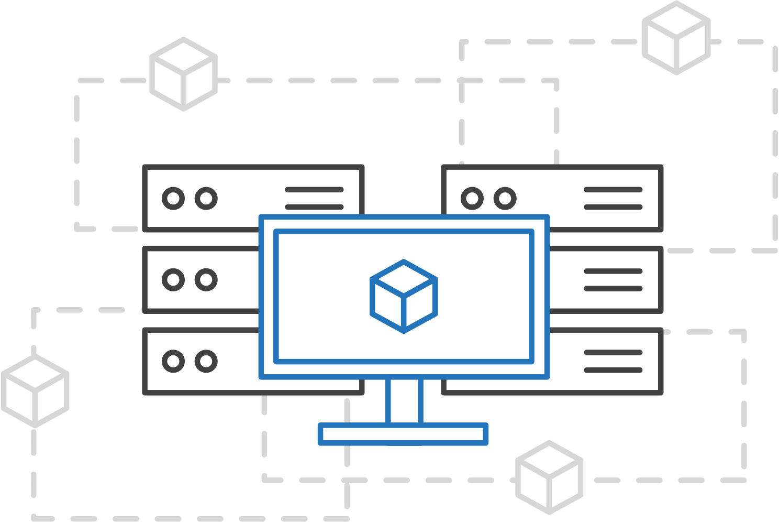
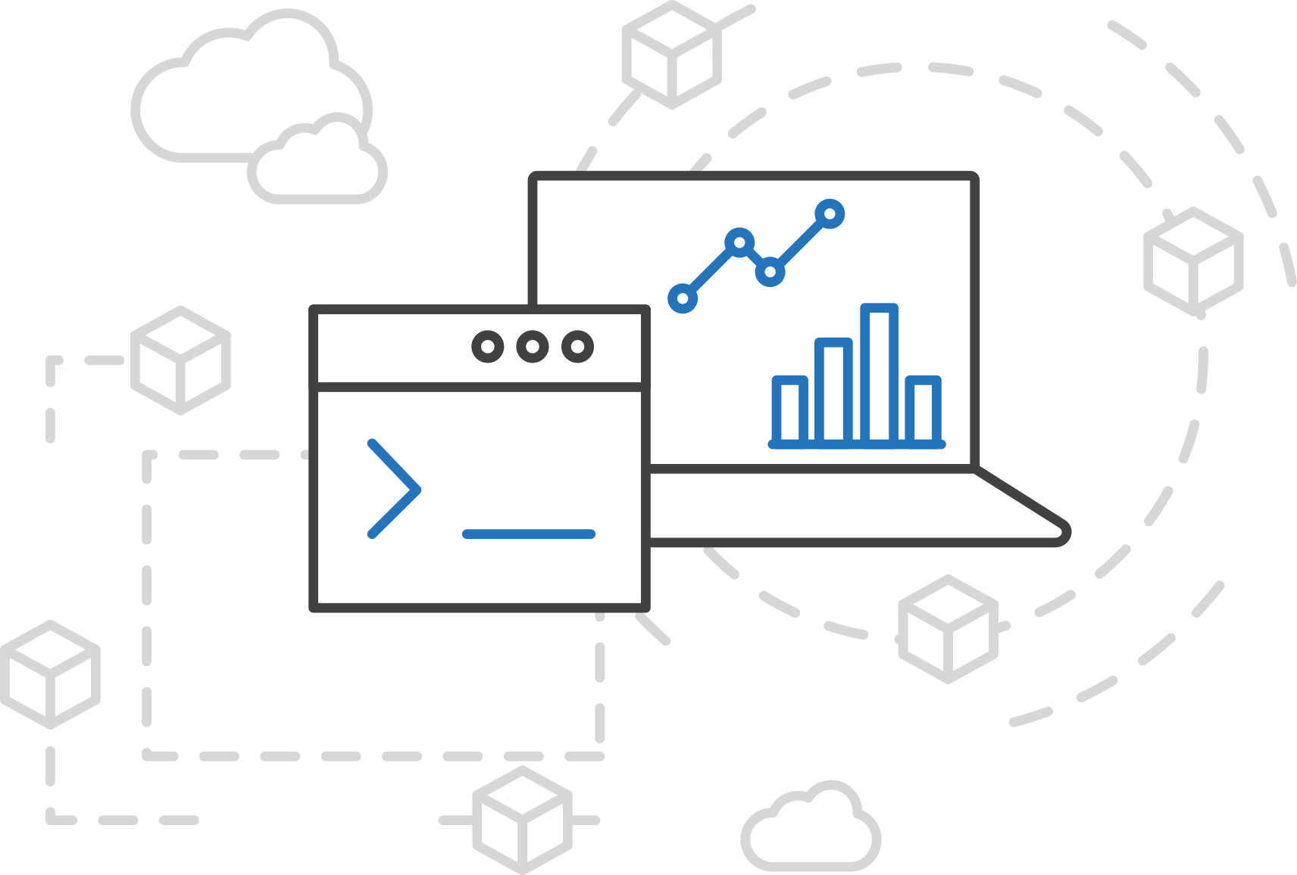
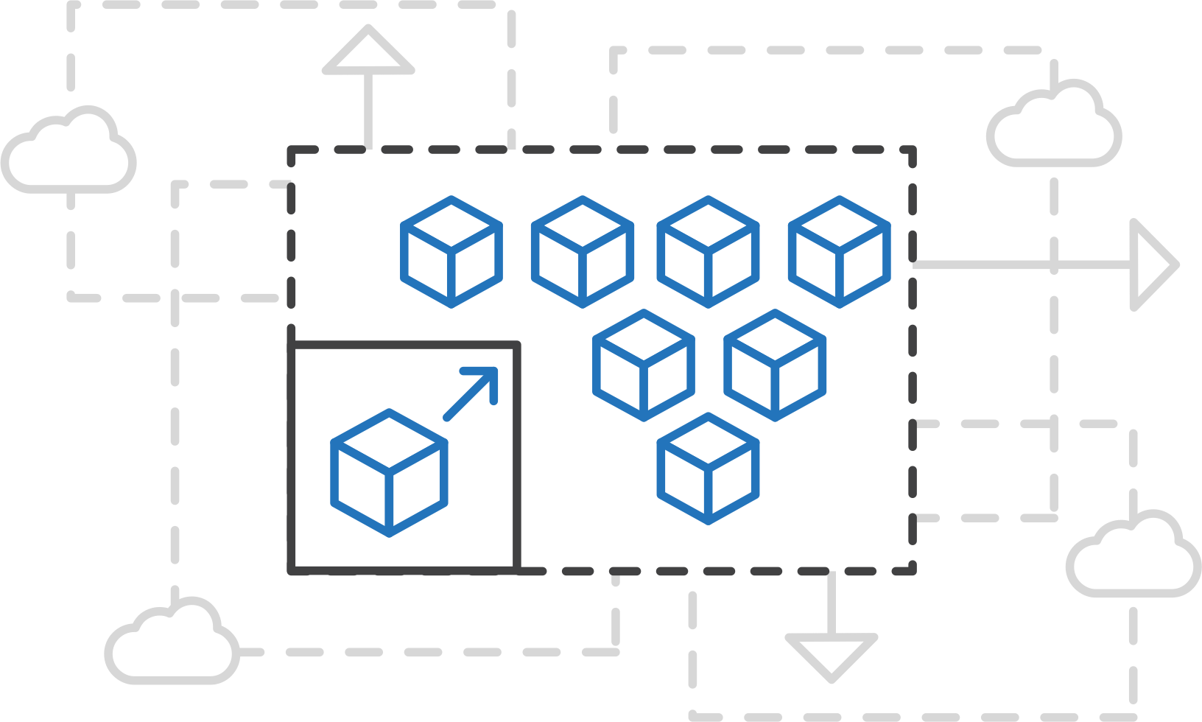
Azure Kubernetes Service (AKS)
Azure Kubernetes Service (AKS)
Simplify the deployment, management, and operations of Kubernetes
Azure Container Instances (ACI)
Azure Container Registry
Open Service Broker API (OSBA)
Focus on your containers not the infrastructure
Work how you want with open-source APIs
Scale and run applications with confidence
Release Automation Tools

Slide 28
Azure Kubernetes Service (AKS)
Azure Kubernetes Service (AKS)
A fully managed Kubernetes cluster
Azure Container Instances (ACI)
Managed control pane
Automated upgrades, patches
Easy cluster scaling
Self-healing
Cost savings
Azure Container Registry
Managed
Application architect
Applications
Open Service Broker API (OSBA)
Operations
Kubernetes
Infrastructure architect
Docker
Release Automation Tools
Azure infrastructure services

Slide 29
Azure Kubernetes Service (AKS)
Azure Kubernetes Service (AKS)
Get started easily
Azure Container Instances (ACI)
$ az aks create -g myResourceGroup -n myCluster --generate-ssh-keys
\ Running ..
$ az aks install-cli
Downloading client to /usr/local/bin/kubectl ..
$ az aks get-credentials -g myResourceGroup -n myCluster
Merged "myCluster" as current context ..
$ kubectl get nodes
NAME STATUS AGE VERSION
aks-mycluster-36851231-0 Ready 4m v1.8.1
aks-mycluster-36851231-1 Ready 4m v1.8.1
aks-mycluster-36851231-2 Ready 4m v1.8.1
Azure Container Registry
Open Service Broker API (OSBA)
Release Automation Tools

Slide 30
Azure Kubernetes Service (AKS)
Azure Kubernetes Service (AKS)
Manage an AKS cluster
Azure Container Instances (ACI)
$ az aks list –o table
Name Location ResourceGroup KubernetesRelease ProvisioningState
------------------ ---------- -------------- ------------------- -------------------
myCluster westus2 myResourceGroup 1.7.7 Succeeded
$ az aks upgrade -g myResourceGroup -n myCluster –-kubernetes-version 1.8.1
\ Running ..
$ kubectl get nodes
NAME STATUS AGE VERSION
aks-mycluster-36851231-0 Ready 12m v1.8.1
aks-mycluster-36851231-1 Ready 8m v1.8.1
aks-mycluster-36851231-2 Ready 3m v1.8.1
$ az aks scale -g myResourceGroup -n myCluster --agent-count 10
\ Running ..
Azure Container Registry
Open Service Broker API (OSBA)
Release Automation Tools

Slide 31
Lab 1

Slide 32
apiVersion: apps/
Kind: deployment
Metadata:
name: rating-web
apiVersion: apps/
Kind: deployment
Metadata:
name: rating-web
apiVersion: apps/
Kind: deployment
Metadata:
name: rating-web
customResorce
micro-web
api-server
port
8000
deployment
service
ingress
rating-web
rating-web
rating-web
port
8080
port
8080
port
8080
pod
pod
rating-web
rating-web
port
8080
port
8080

Slide 33
Azure Container Registry
Azure Container Registry
Open source community
Azure Kubernetes Service (AKS)
Release automation tools
Containers 101
Getting started
Azure container technology
Open Service Broker for Azure (OSBA)
Customer success stories
Container orchestration
Azure Container Instances (ACI)

Slide 34
Azure Container Registry
Azure Kubernetes Service (AKS)
Azure Container Instances (ACI)
OSBA
App Service
Azure Container Registry (ACR)
Partner services
Azure services
PaaS
Azure Container Registry
OpenShift
SQL Database
Azure Kubernetes Service (AKS)
Service Fabric
Batch
Pivotal Cloud Foundry
Redis Cache
ACS Engine
Open Service Broker API (OSBA)
Docker Enterprise Edition
CosmosDB
Virtual kubelet
Mesosphere DC/OS
And more!
Azure Container Instances (ACI)
Azure Virtual Machines
Virtual Machine Scale Sets (VMSS)
Release Automation Tools
Azure
IaaS

Slide 35
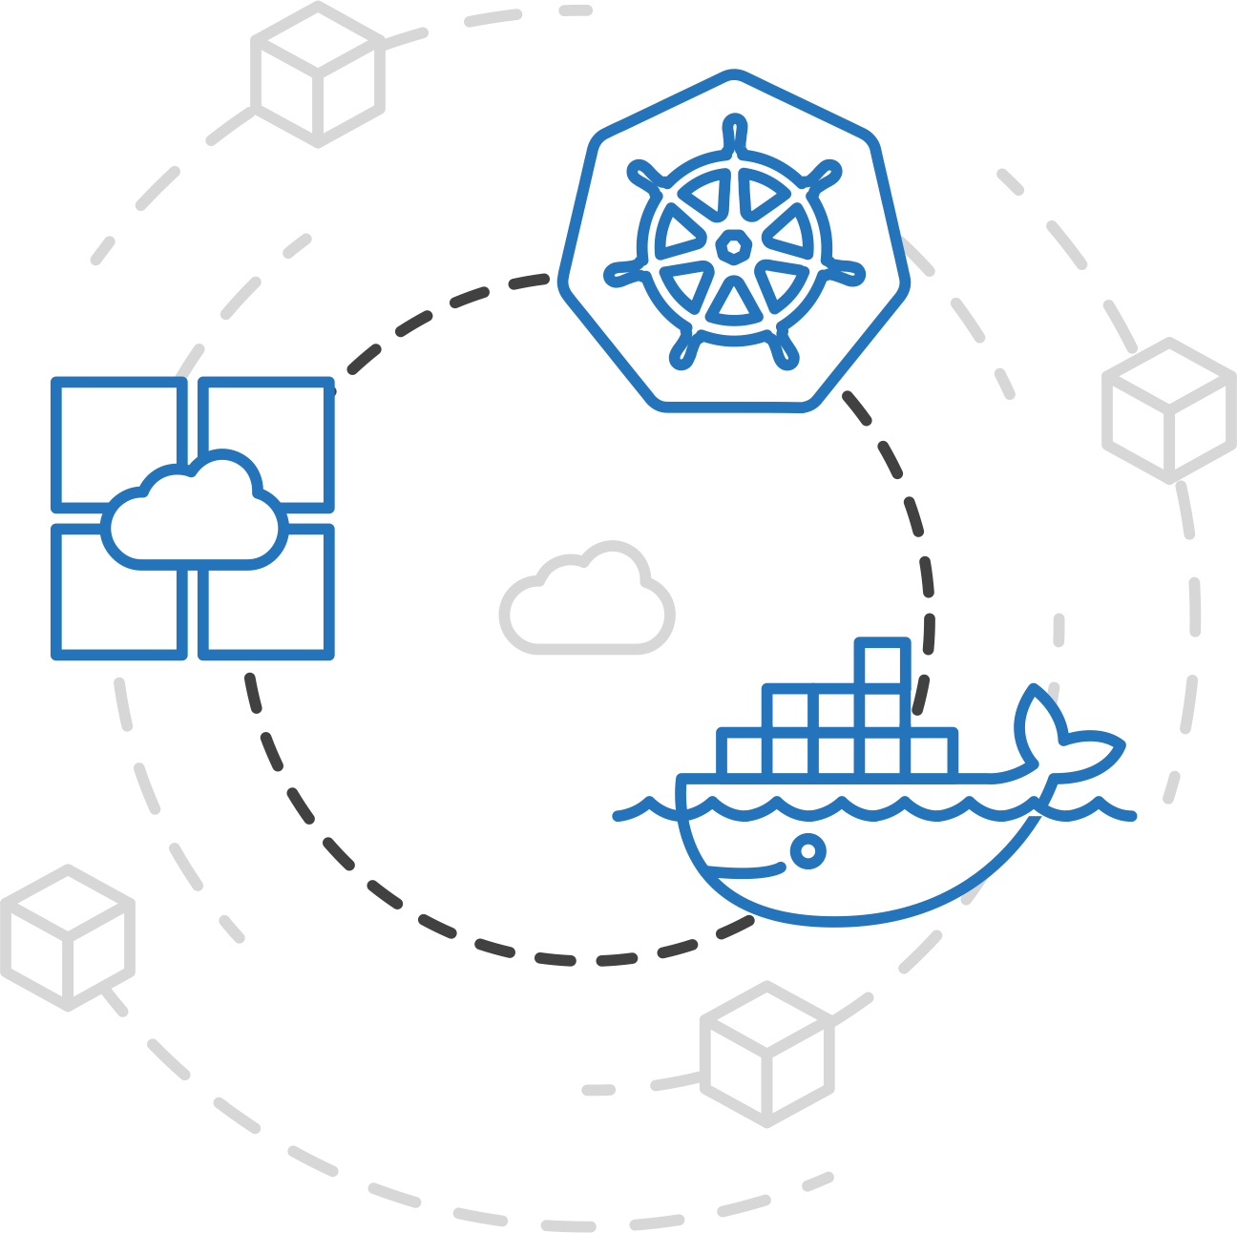
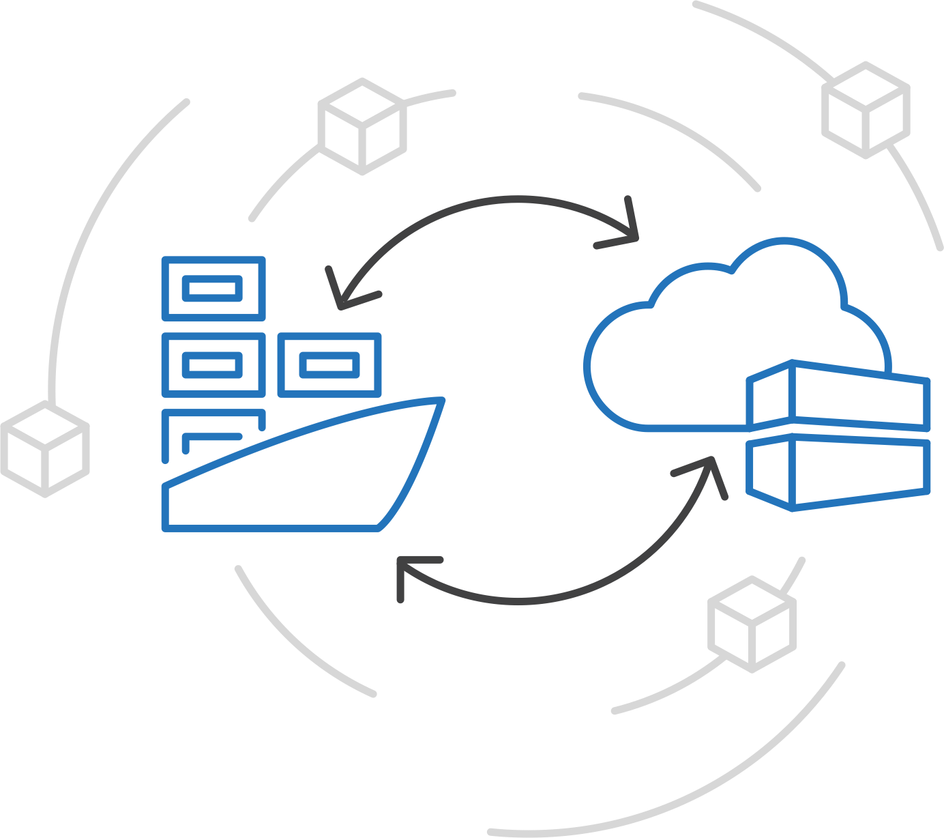
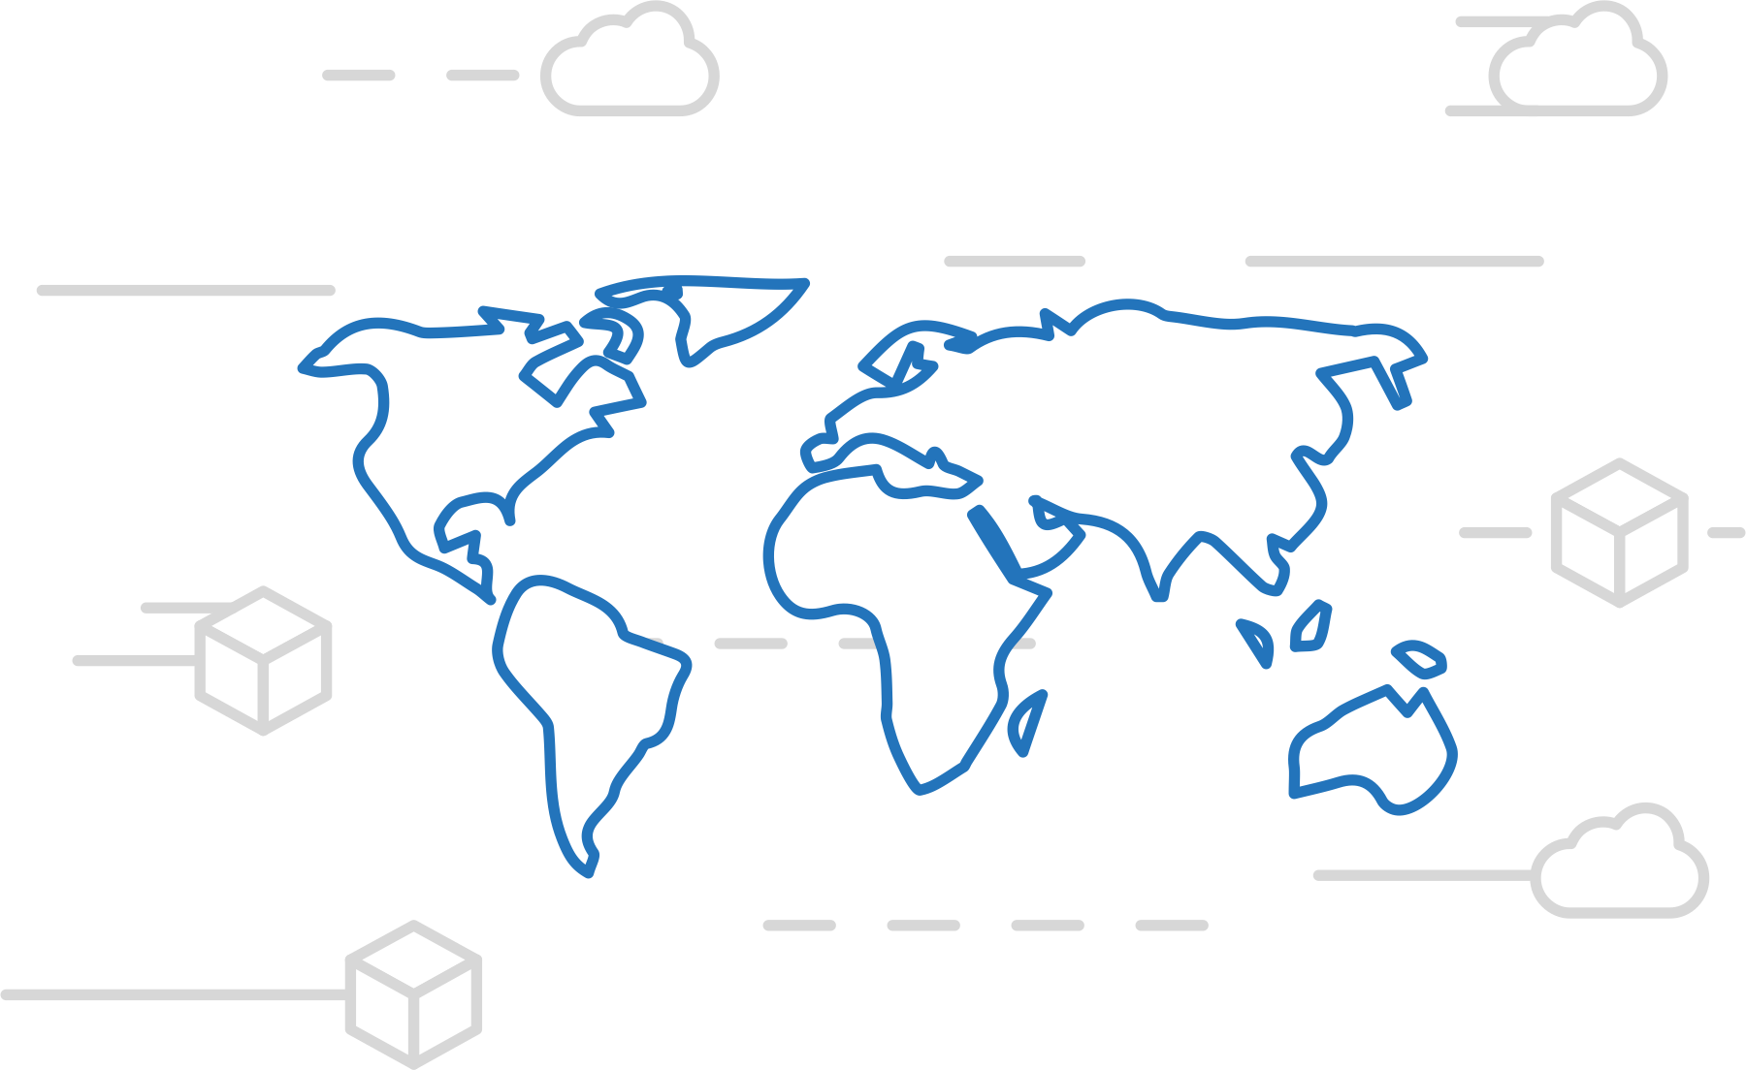
Azure Container Registry
Azure Kubernetes Service (AKS)
Manage a Docker private registry as a first-class Azure resource
Azure Container Instances (ACI)
Azure Container Registry
Open Service Broker API (OSBA)
Manage images for all types of containers
Use familiar, open-source Docker CLI tools
Azure Container Registry geo-replication
Release Automation Tools

Slide 36
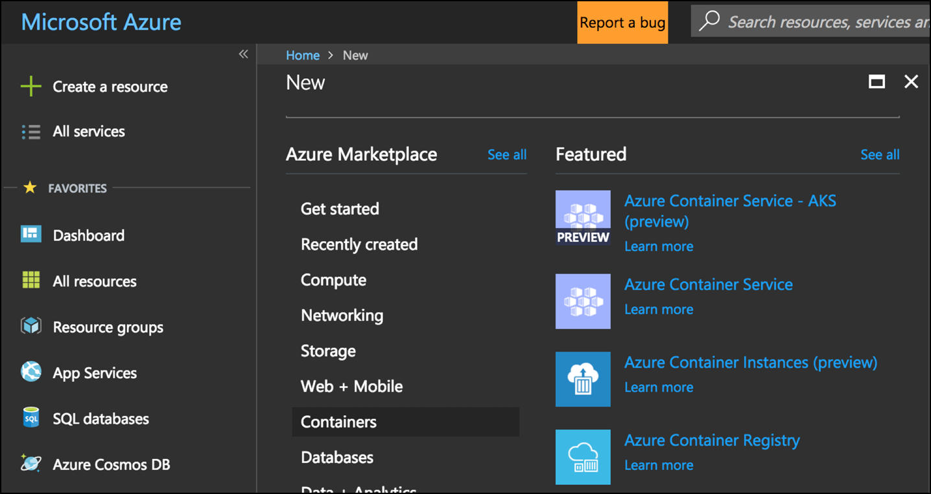
Azure Container Registry
Azure Kubernetes Service (AKS)
Create a container in the Registry quickly
Azure Container Instances (ACI)
Azure Container Registry
Open Service Broker API (OSBA)
Release Automation Tools

Slide 37
Release automation tools
Azure Container Registry
Open source community
Azure Kubernetes Service (AKS)
Release automation tools
Containers 101
Getting started
Azure container technology
Open Service Broker for Azure (OSBA)
Customer success stories
Container orchestration
Azure Container Instances (ACI)

Slide 38
DevOps Practices Arrive
Developers: Test, Build, Code, Plan
Operations: Monitor, Release, Deploy, Operate
DevOps Features
Speed of application delivery/updates
Faster time to value
Repeatable/consistent
Automated testing
Traceability of process
Applying developer patterns to infrastructure
Infrastructure as code
Ops teams embracing source control
Centralized monitoring, logging, debugging
CI / CD – key aspect of quality DevOps

Slide 39
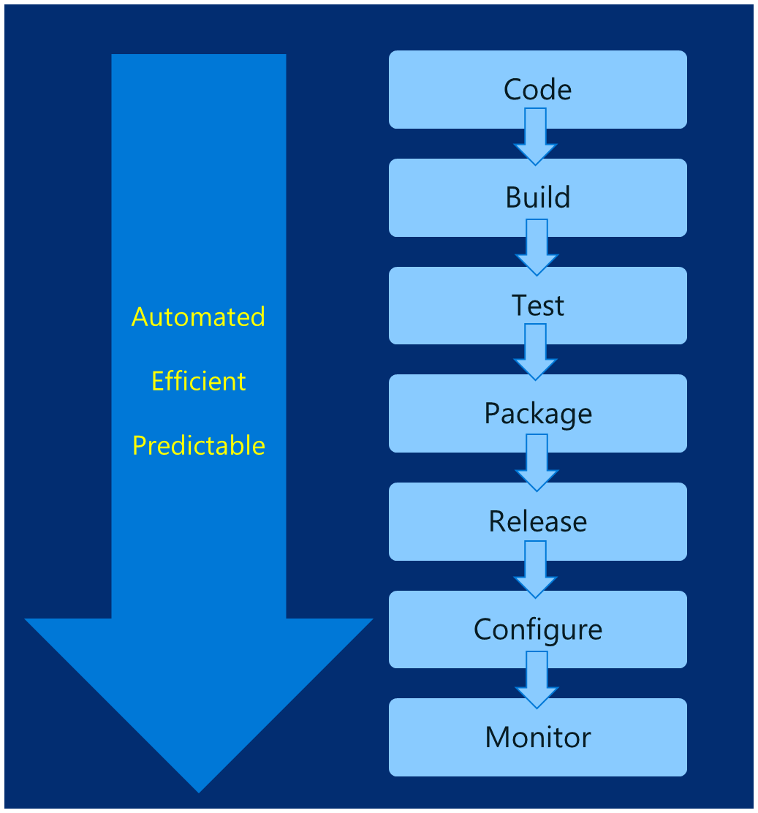
DevOps – Why?
Deploy 200 times more frequently
Go from code check-in to production 2,555 times faster
Recover from failure 24 times faster
Spent 50% less time remediating security challenges
Spent 22% less time on unplanned work
2.2 times more likely to believe their places a great place to work
Source: https://puppet.com/resources/white-paper/2016-state-of-devops-report

Slide 40
Common Toolsets
Jenkins
Visual Studio Team Services
Spinnaker and Netflix OSS
Travis
TeamCity
CircleCI
Additional utilities: code quality scanning, security, collaboration, etc.

Slide 41

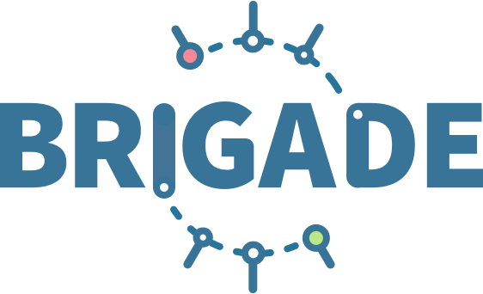


Release automation tools
Azure Kubernetes Service (AKS)
Simplifying the Kubernetes experience
Azure Container Instances (ACI)
Azure Container Registry
Open Service Broker API (OSBA)
Streamlined Kubernetes development
The package manager for Kubernetes
Event-driven scripting for Kubernetes
Visualization dashboard for Brigade
Release Automation Tools

Slide 42
Release automation workflow
Azure Kubernetes Service (AKS)
New code directory
Create a code file
Draft creates a dockerfile and a Helm chart for service composition
Azure Container Instances (ACI)
New directory
Add a code file
Draft create
Azure Container Registry
Yes
Does it work?
Git push
Draft commit
Draft up
Open Service Broker API (OSBA)
No
Deploy code container chart
CI/CD
Release Automation Tools
Draft helps devs get running
Draft helps devs and operations iterate on containers and services
Artifacts push to cloud, controlled by CI/CD processes

Slide 43
Release automation workflow
Azure Kubernetes Service (AKS)
Once developers are up and running—or working on a service that is in a complex system—Draft ALSO helps devs ignore artifacts and focus on code
Azure Container Instances (ACI)
git clone
Draft pack-reps
Draft create
Azure Container Registry
Yes
Does it work?
git push
Draft up
Open Service Broker API (OSBA)
No
Debug
CI/CD
Release Automation Tools
Draft helps devs get running
Draft helps devs and operations iterate on containers and services
Artifacts push to cloud, controlled by CI/CD processes

Slide 44
Release automation workflow
Azure Kubernetes Service (AKS)
Create
Azure Container Instances (ACI)
Draft create
Have code?
No
New
Draft page
Azure Container Registry
Yes
Builds image/config. to be deployed
Staged?
Yes
Code
Container
Configuration
Draft create or Draft create-pack (if specific artifacts exist)
Deploy image (AKS)
Deploy to staging
No
Open Service Broker API (OSBA)
Push image
Canary deploy to production
CD: No staging
No
Testing good?
Move to dev cluster
Change
Code
Container
Configuration
Actual development, Draft up/connect iteration
The building process: Brigade, Jenkins, VS TS
Build container
Telemetry successful?
Rollback
Yes
No
2 factor authentication
Push to production as canary
Release Automation Tools
Yes
Git push
Pull code
Rollout
Code/artifacts ready

Slide 45
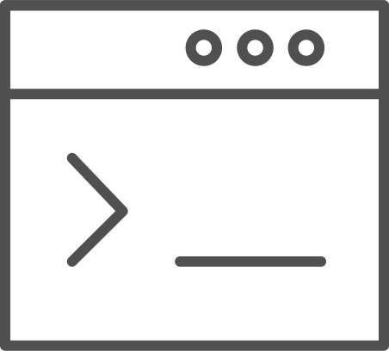
Draft
Azure Kubernetes Service (AKS)
Simple app development and deployment – into any Kubernetes cluster
Azure Container Instances (ACI)
Azure Container Registry
Open Service Broker API (OSBA)
Simplified development
Using two simple commands, developers can now begin hacking on container-based applications without requiring Docker or even installing Kubernetes themselves
Language support
Draft detects which language your app is written in, and then uses packs to generate a Dockerfile and Helm Chart with the best practices for that language
Release Automation Tools

Slide 46

Draft
Azure Container Service (AKS)
Draft in action
Azure Container Instances (ACI)
Azure Container Registry
Open Service Broker API (OSBA)
Release Automation Tools

Slide 47
Helm
Azure Kubernetes Service (AKS)
The best way to find, share, and use software built for Kubernetes
Azure Container Instances (ACI)
Azure Container Registry
Manage complexity
Charts can describe complex apps; provide repeatable app installs, and serve as a single point of authority
Easy updates
Take the pain out of updates with in-place upgrades and custom hooks
Simple sharing
Charts are easy to version, share, and host on public or private servers
Rollbacks
Use helm rollout to roll back to an older version of a release with ease
Open Service Broker API (OSBA)
Release Automation Tools

Slide 48

Helm
Azure Kubernetes Service (AKS)
Helm Charts helps you define, install, and upgrade even the most complex Kubernetes application
Azure Container Instances (ACI)
services
ci
db
Azure Container Registry
load balancer
custom
…
Chart.yml
Open Service Broker API (OSBA)
Release Automation Tools

Slide 49
Helm Charts
Application definition
Consists of:
Metadata
Kubernetes resource definitions
Configuration
Documentation
Stored in chart repository
Any HTTP server that can house YAML/tar files (Azure, GitHub pages, etc.)
Public repo with community supported charts (eg – Jenkins, Mongo, etc.)
Helm (CLI) + Tiller (sever side)
Release: Instance of chart + values -> Kubernetes

Slide 50
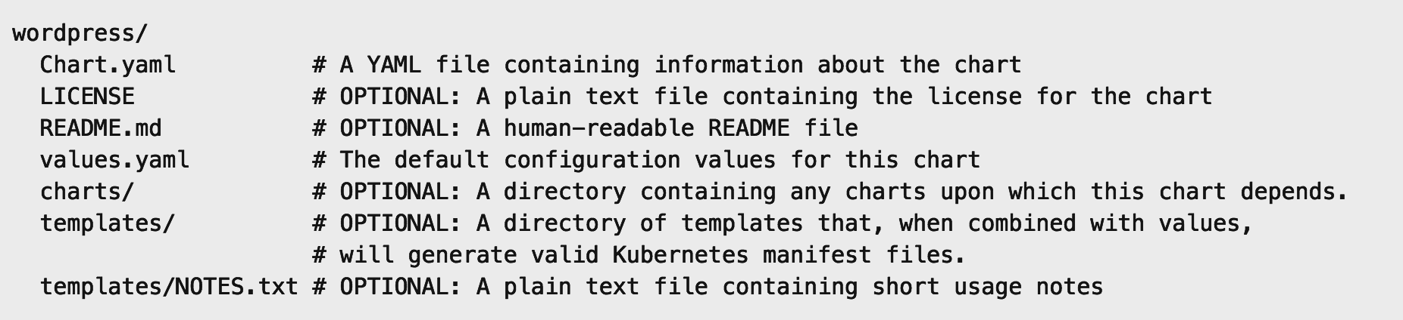
Chart structure
Layout
Helm expects a strict chart structure

Slide 51
Helm values.yaml
The knobs and dials:
A values.yaml file provided with the chart that contains default values
Use -f to provide your own values overrides
Use --set to override individual values

Slide 52
Monitoring

Slide 53

Current monitoring is static in nature

Slide 54
Need to monitor for dynamic environments
Pod
Pod
Pod
Pod
Pod
Pod
Pod
Pod
Pod
Pod
Pod
Pod
Pod
Pod
Pod
Pod

Slide 55
Application Health and Readiness
Kubelets on workers use liveness and readiness probes to know when to restart a container or start directing traffic
Liveness check: when to restart
Readiness check: when to forward Service traffic to a pod
Notes:
Look at liveness
Look at readiness

Slide 56
Monitoring: What indicators matter in Kubernetes
Cluster health: total number of nodes, pods, etc
Node health: available compute resources, health
Application health
Tooling Examples
Datadog
Prometheus
InfluxData
Cloud-specific: OMS (Azure), CloudWatch (AWS)
Notes:
https://docs.datadoghq.com/integrations/kubernetes/

Slide 57
Logging
Pod logs: applications must log to standard out!
Cluster-wide event logs
Logging forwarder solutions
fluentd
logstash
Log indexers
OMS Log Analytics
Splunk
ELK stack

Slide 58
Azure Container Instances (ACI)
Azure Container Registry
Open source community
Azure Kubernetes Service (AKS)
Release automation tools
Containers 101
Getting started
Azure container technology
Open Service Broker for Azure (OSBA)
Customer success stories
Container orchestration
Azure Container Instances (ACI)

Slide 59
Azure Container Instances (ACI)
Azure Kubernetes Service (AKS)
PREVIEW
Azure Container Instances (ACI)
OSBA
App Service
Azure Container Registry (ACR)
Partner services
Azure services
PaaS
Azure Container Registry
OpenShift
SQL Database
Azure Kubernetes Service (AKS)
Service Fabric
Batch
Pivotal Cloud Foundry
Redis Cache
ACS Engine
Open Service Broker API (OSBA)
Docker Enterprise Edition
CosmosDB
Virtual kubelet
Mesosphere DC/OS
And more!
Azure Container Instances (ACI)
Azure Virtual Machines
Virtual Machine Scale Sets (VMSS)
Release Automation Tools
Azure
IaaS

Slide 60
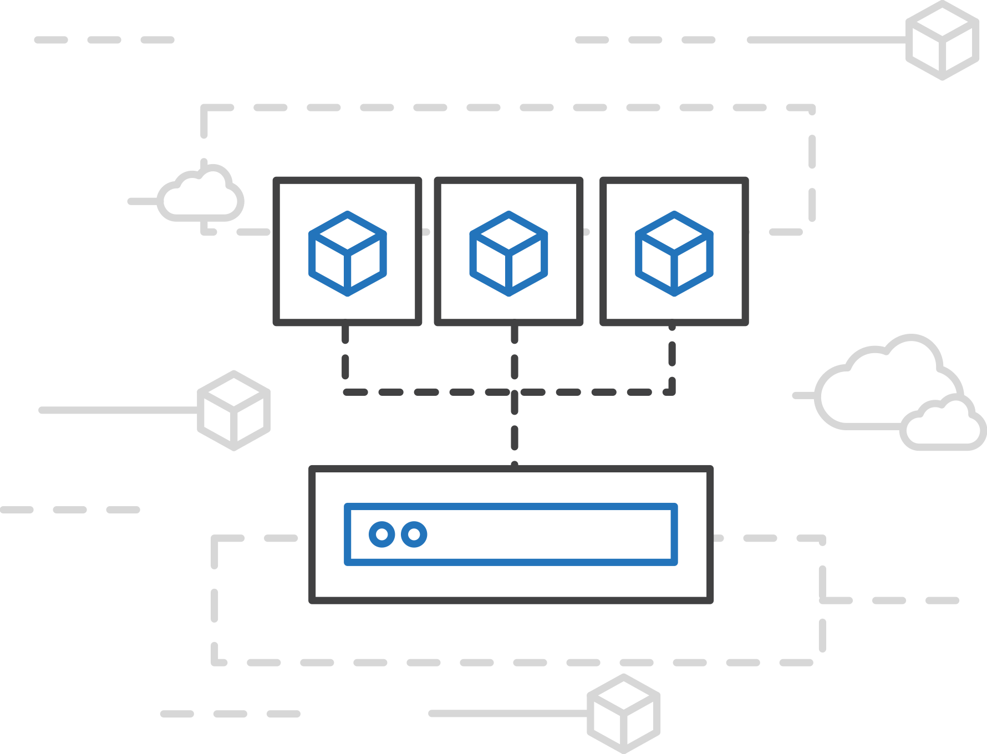
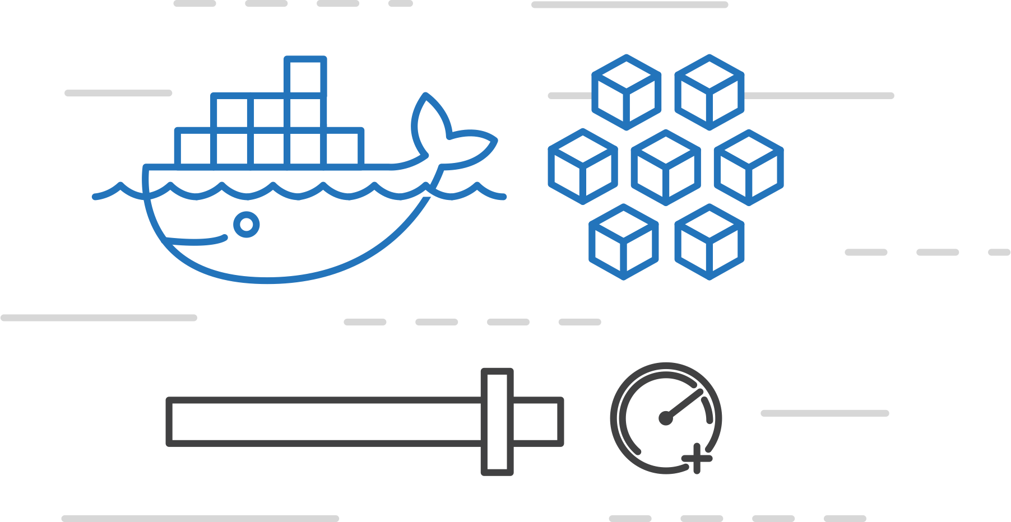
Azure Container Instances (ACI)
Azure Kubernetes Service (AKS)
PREVIEW
Easily run containers on Azure with a single command
Azure Container Instances (ACI)
Azure Container Registry
Open Service Broker API (OSBA)
Start using containers right away
Cloud-scale container capacity
Hyper-visor isolation
Release Automation Tools

Slide 61
Azure Container Instances (ACI)
Azure Kubernetes Service (AKS)
PREVIEW
Get started easily
Azure Container Instances (ACI)
$ az container create --name mycontainer --image microsoft/aci-helloworld --resource-group myResourceGroup --ip-address public
"ipAddress": {
"ip": "52.168.86.133",
"ports": [...]
},
"location": "eastus",
"name": "mycontainer",
"osType": "Linux",
"provisioningState": "Succeeded",
$ curl 52.168.86.133
<html>
<head>
<title>Welcome to Azure Container Instances!</title>
</head>
Azure Container Registry
Open Service Broker API (OSBA)
Release Automation Tools

Slide 62
Azure Container Instances (ACI)
Azure Kubernetes Service (AKS)
PREVIEW
Create an Azure Container Instance quickly
Azure Container Instances (ACI)
Azure Container Registry
Open Service Broker API (OSBA)
Release Automation Tools

Slide 63
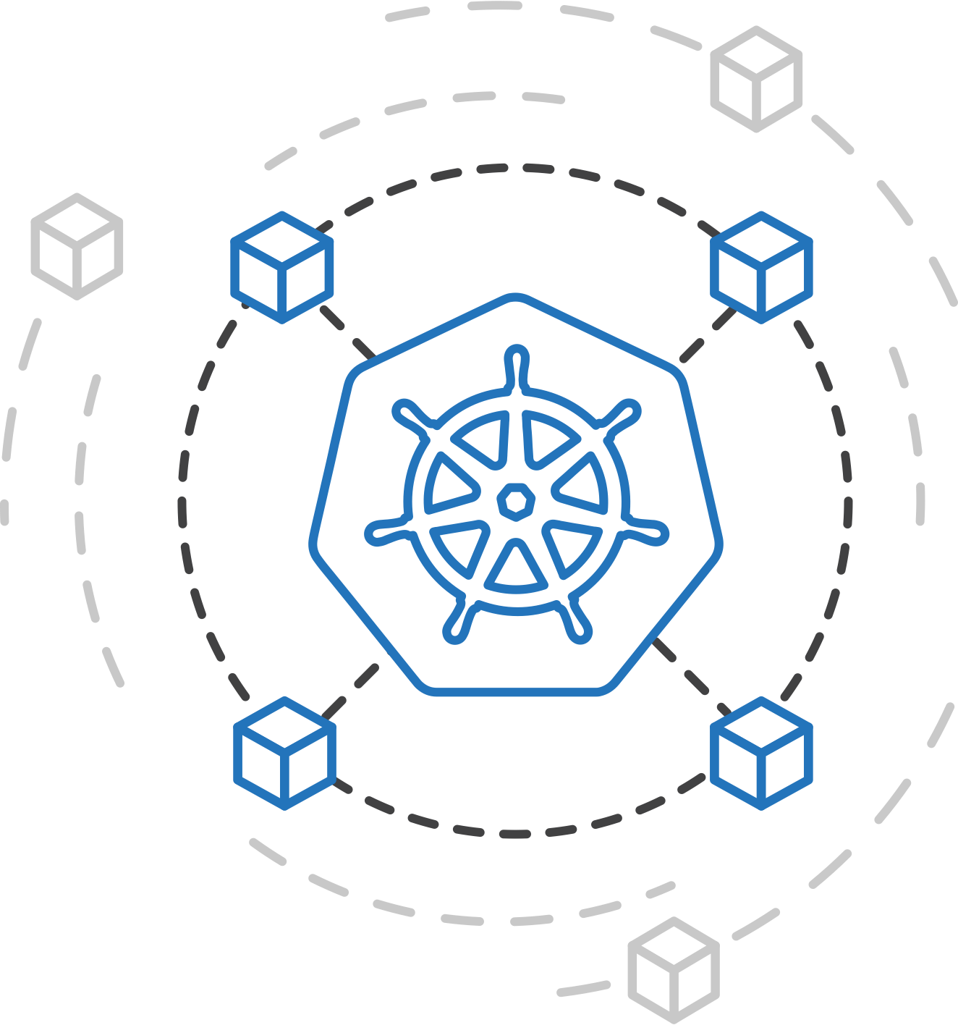
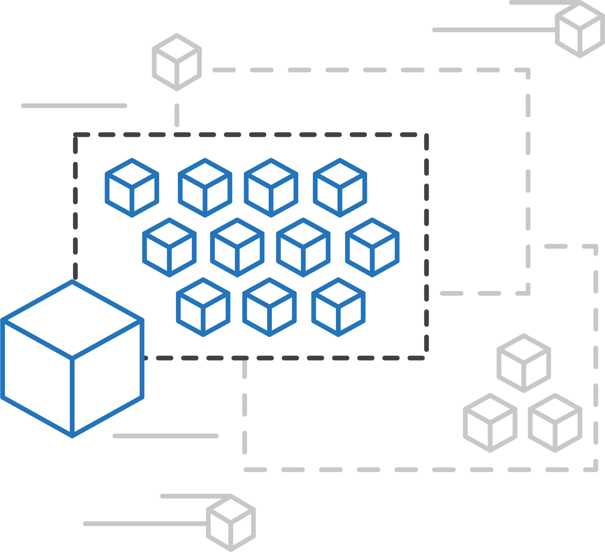
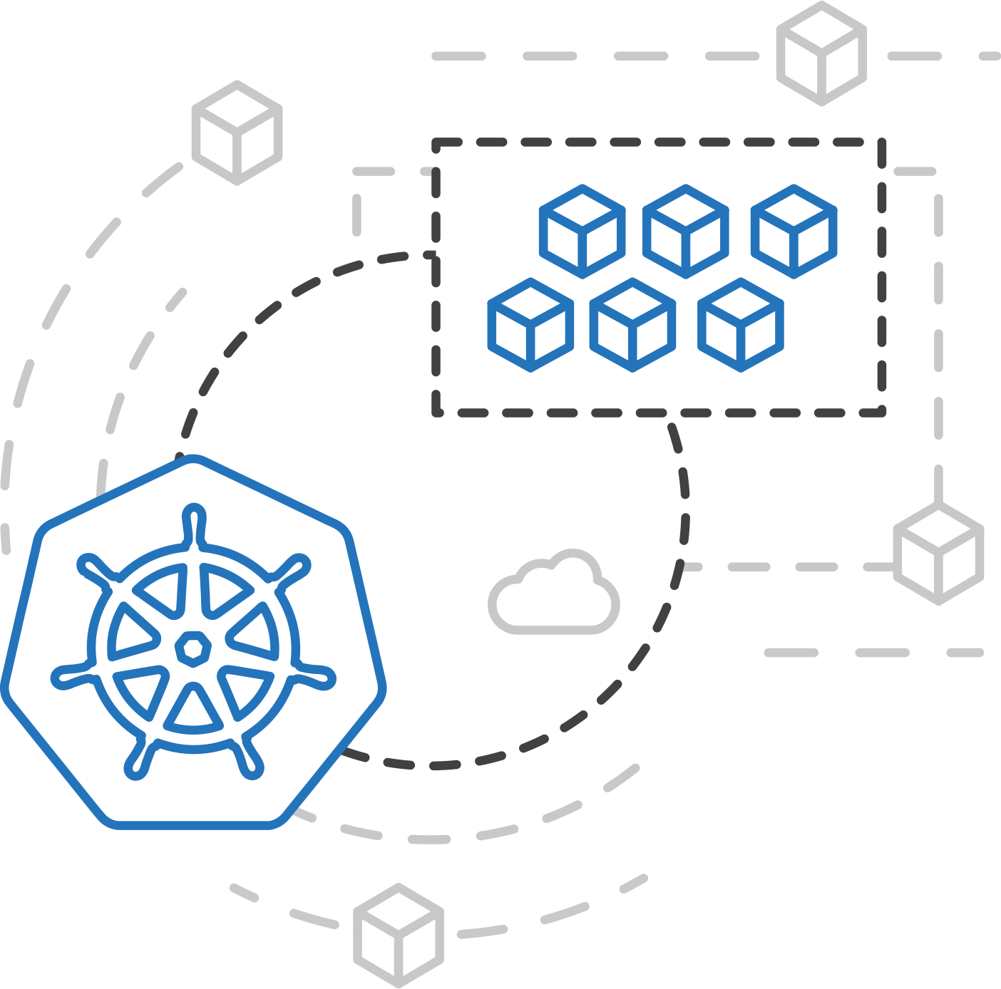
Azure Kubernetes Service (AKS)
Azure Container Instances (ACI)
PREVIEW
ACI Connector for Kubernetes
Azure Container Instances (ACI)
Azure Container Registry
Open Service Broker API (OSBA)
Kubernetes provides rich orchestration capabilities
ACI provides infinite container-based scale
The ACI Connector for K8s brings them together
Release Automation Tools

Slide 64
Azure Container Instances (ACI)
Azure Kubernetes Service (AKS)
PREVIEW
Bursting with the ACI Connector
Azure Container Instances (ACI)
VM
VM
Pod
Waste
Pod
Pod
Pod
Waste
Pod
Pod
Pod
Pod
Azure Container Registry
Azure Container Instances (ACI)
Pod
Pod
Pod
Pod
Pod
Application architect
Kubernetes control pane
ACI Connector
Pod
Pod
Pod
Pod
Pod
Pod
Pod
Pod
Pod
Pod
Open Service Broker API (OSBA)
Pod
Pod
Pod
Pod
Pod
Deployment/ tasks
Pod
Pod
Pod
Pod
Pod
Infrastructure architect
Release Automation Tools
Pod
Waste
Pod
Pod
Pod
Waste
Pod
Pod
Pod
Pod
VM
VM

Slide 65
Azure Kubernetes Service (AKS)
Azure Container Instances (ACI)
PREVIEW
Virtual Kubelet
Azure Container Instances (ACI)
Kubernetes API
Azure Container Registry
Node
Node
Node
Node
virtual kubelet
Kubelet
Kubelet
Kubelet
Kubelet
Open Service Broker API (OSBA)
Release Automation Tools
Typical kubelets implement the pod and container operations for each node as usual.
Virtual kublet registers itself as a “node” and allows developers to program their own behaviors for operations on pods and containers.

Slide 66

Open Service Broker for Azure
Azure Container Registry
Open source community
Azure Kubernetes Service (AKS)
Release automation tools
Containers 101
Getting started
Azure container technology
Open Service Broker for Azure (OSBA)
Customer success stories
Container orchestration
Azure Container Instances (ACI)

Slide 67

Open Service Broker for Azure (OSBA)
Azure Kubernetes Service (AKS)
Azure Container Instances (ACI)
OSBA
App Service
Azure Container Registry (ACR)
Partner services
Azure services
PaaS
Azure Container Registry
OpenShift
SQL Database
Azure Kubernetes Service (AKS)
Service Fabric
Batch
Pivotal Cloud Foundry
Redis Cache
ACS Engine
Open Service Broker API (OSBA)
Docker Enterprise Edition
CosmosDB
Virtual kubelet
Mesosphere DC/OS
And more!
Azure Container Instances (ACI)
Azure Virtual Machines
Virtual Machine Scale Sets (VMSS)
Release Automation Tools
Azure
IaaS

Slide 68
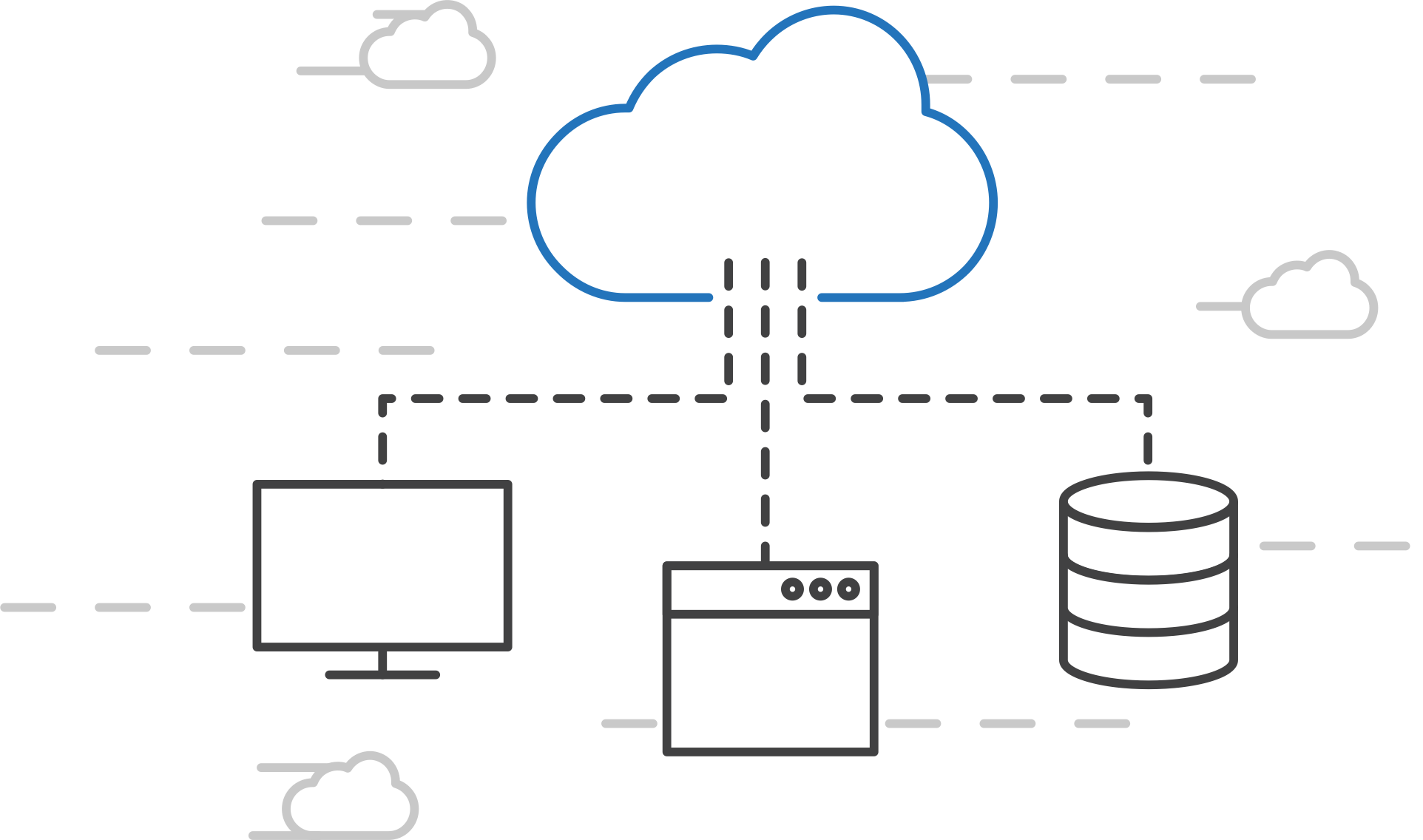
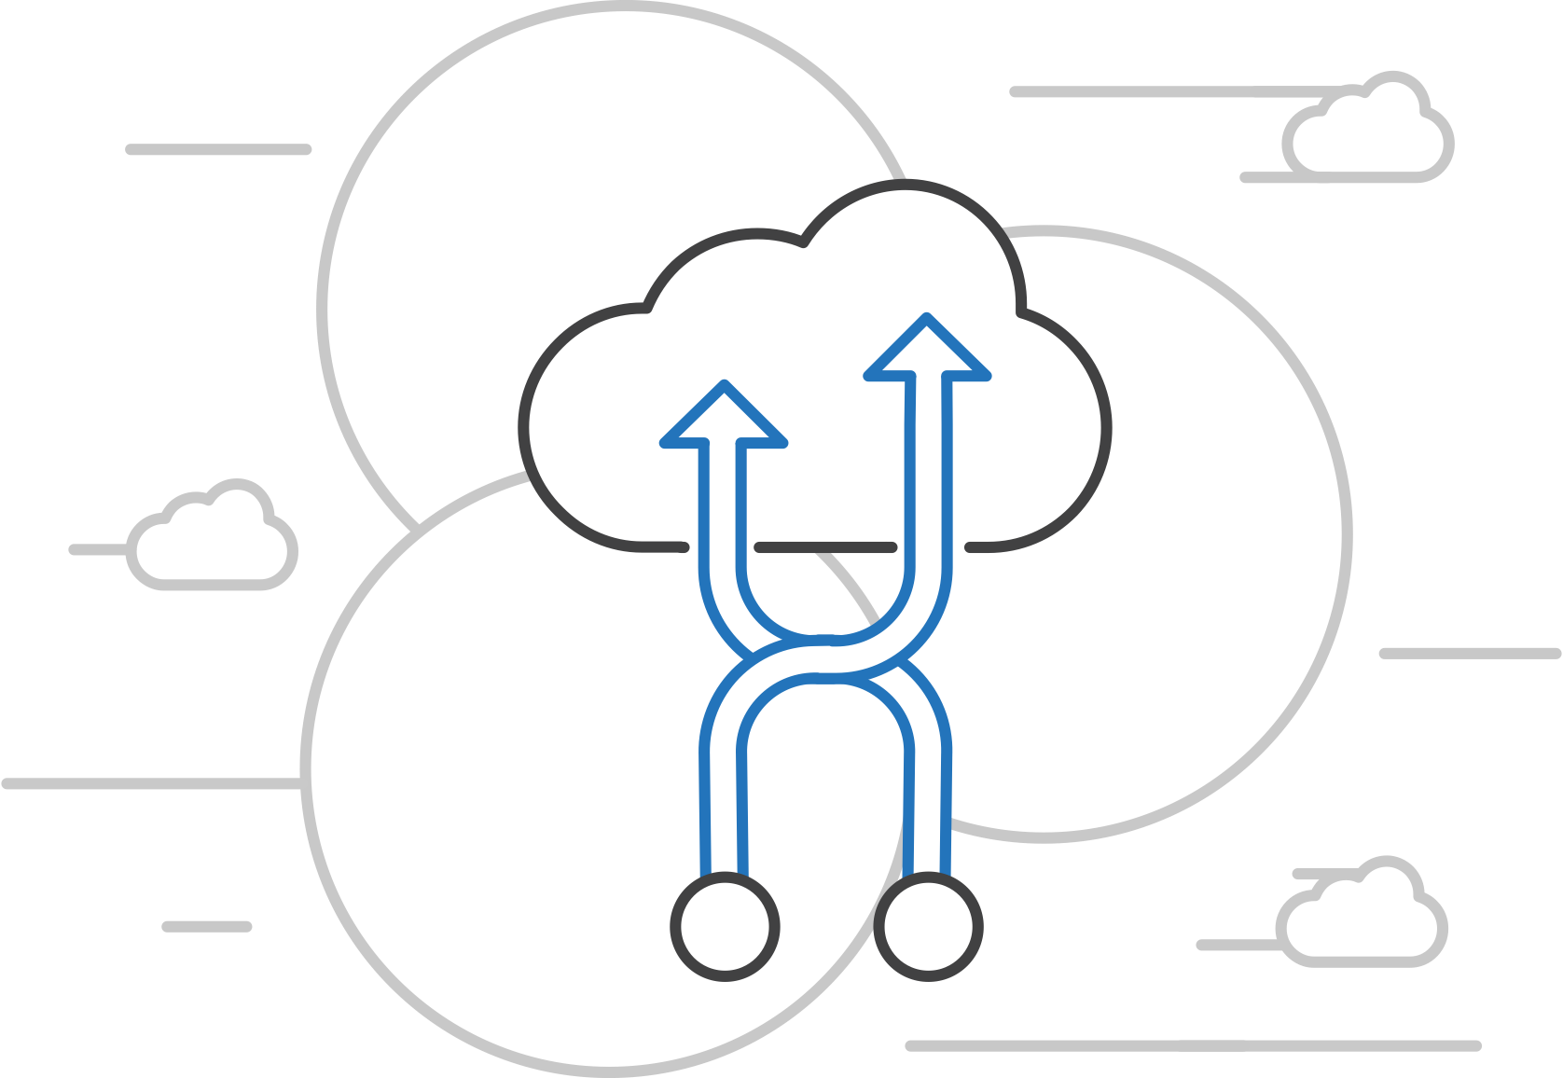
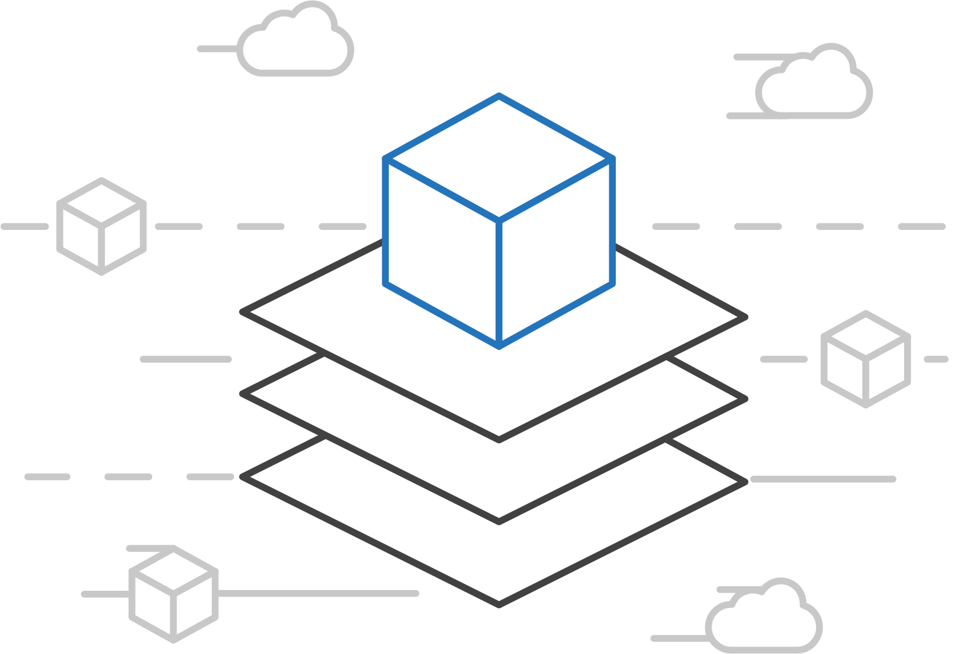
Open Service Broker for Azure (OSBA)
Azure Kubernetes Service (AKS)
Connecting containers to Azure services and platforms
Azure Container Instances (ACI)
Azure Container Registry
Open Service Broker API (OSBA)
A standardized way to connect with Azure services
Simple and flexible service integration
Compatible across numerous platforms
Release Automation Tools

Slide 69
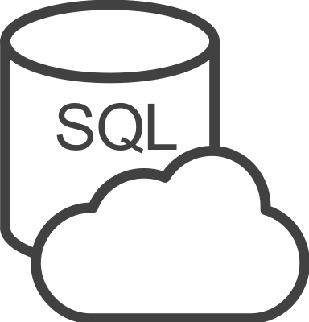




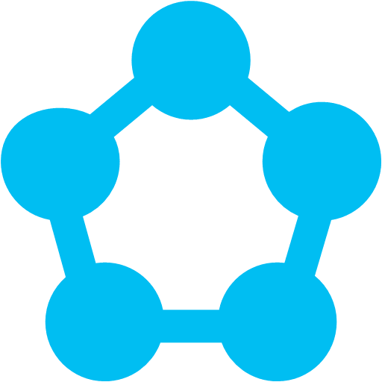
Open Service Broker for Azure (OSBA)
Azure Kubernetes Service (AKS)
An implementation of the Open Service Broker API
Azure Container Instances (ACI)
Azure SQL Database
Redis Cache
CosmosDB
And more!
Azure Container Registry
Open Service Broker for Azure (OSBA)
Open Service Broker API (OSBA)
Release Automation Tools
OpenShift
Cloud Foundry
Service Fabric (Coming soon)
Kubernetes (AKS)

Slide 70
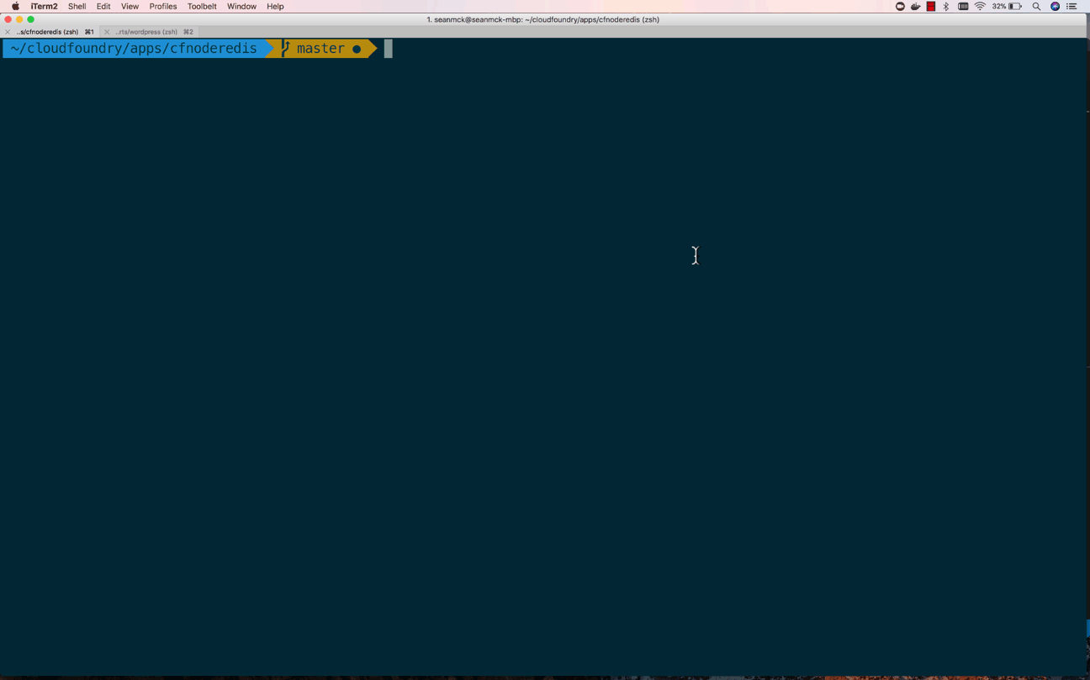
Open Service Broker for Azure (OSBA)
OSBA in action
Azure Container Instances (ACI)
Azure Container Registry
Open Service Broker API (OSBA)
Release Automation Tools

Slide 71
Open Service Broker for Azure (OSBA)
Azure Kubernetes Service (AKS)
Getting started with ease
Azure Container Instances (ACI)
$ helm repo add azure Azure/helm-charts
$ helm install azure/service-broker
$ helm install azure/wordpress
Azure Container Registry
Open Service Broker API (OSBA)
Release Automation Tools

Slide 72
Managing Storage and State

Slide 73
Managing State For Containers
Azure
Data Service
Local Storage
Remote Storage
Pod
Pod
Pod
CosmosDB

Slide 74
Scaling Applications

Slide 75
Application Scaling Strategies
Infrastructure Level
Increase/decrease the number of VM’s running in the cluster
Azure infrastructure function
via AKS API/CLI (utilizes Azure Availability Sets)
Auto-scaling coming to AKS soon
Application Level
Increase/decrease the number of pods for a given service
Handled by the orchestrator or the application itself
Kubernetes Horizontal Pod Autoscaling
These functions should be coordinated

Slide 76
Scaling Pods
Pod
Pod
Pod
Pod
Pod
Pod

Slide 77
Scaling Host
Pod
Pod
Pod
Pod
Pod
Pod
Pod
Pod

Slide 78
Scaling the ACS Cluster

Slide 79
Upgrading Kubernetes in AKS

Slide 80
Brigade
Azure Kubernetes Service (AKS)
Run scriptable, automated tasks in the cloud — as part of your Kubernetes cluster
Azure Container Instances (ACI)
Azure Container Registry
Open Service Broker API (OSBA)
Simple, powerful pipes
Each project gets a brigade.js config file, which is where you can write dynamic, interwoven pipelines and tasks for your Kubernetes cluster
Runs inside your cluster
By running Brigade as a service inside your Kubernetes cluster, you can harness the power of millions of available Docker images
Release Automation Tools

Slide 81
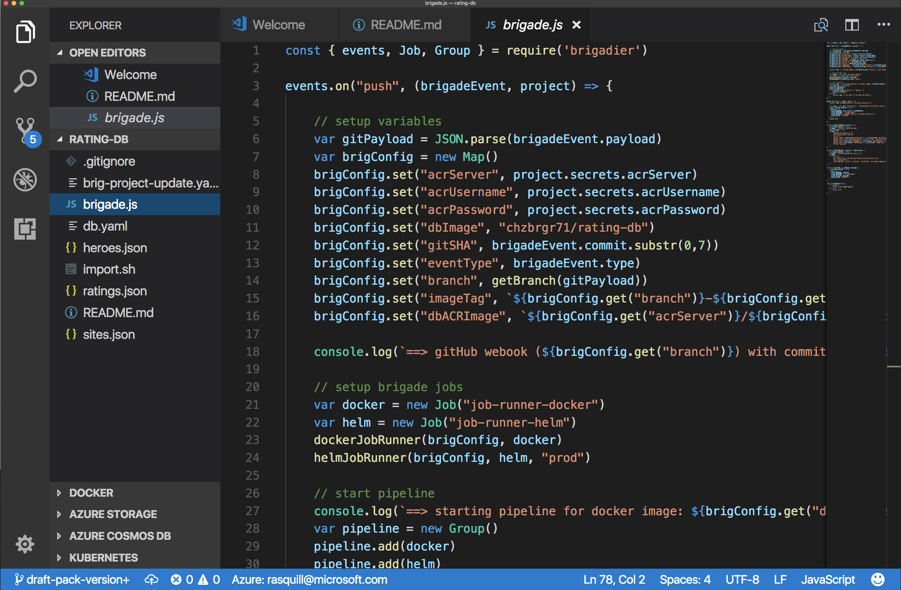
Brigade
Azure Kubernetes Service (AKS)
Brigade in action
Azure Container Instances (ACI)
Azure Container Registry
Open Service Broker API (OSBA)
Release Automation Tools

Slide 82
Kashti
Azure Kubernetes Service (AKS)
A simple UI to display build results and logs
Azure Container Instances (ACI)
Azure Container Registry
Simple visualizations
A web dashboard for Brigade, helping to easily visualize and inspect your Brigade builds
Driving deep insights
Make Brigade DevOps workflows— projects, scripts, and jobs—and their events visible instantly
Open Service Broker API (OSBA)
Release Automation Tools

Slide 83
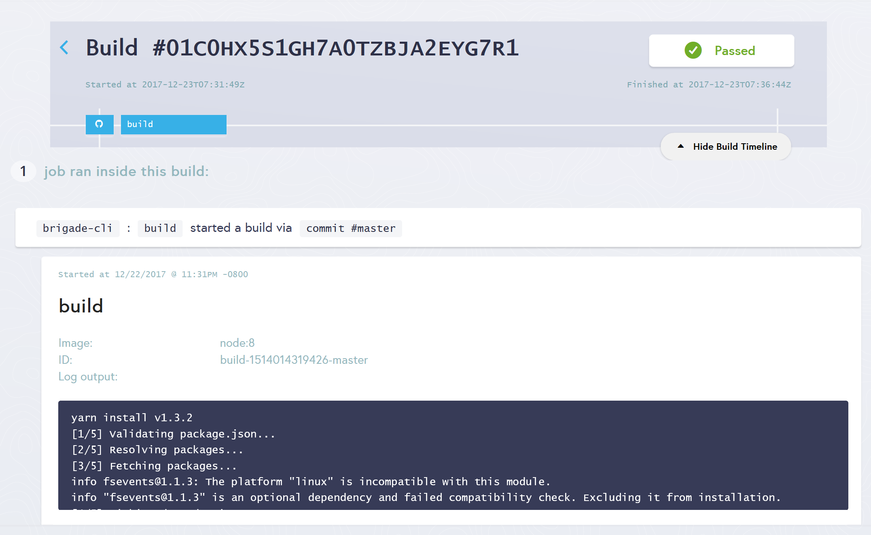
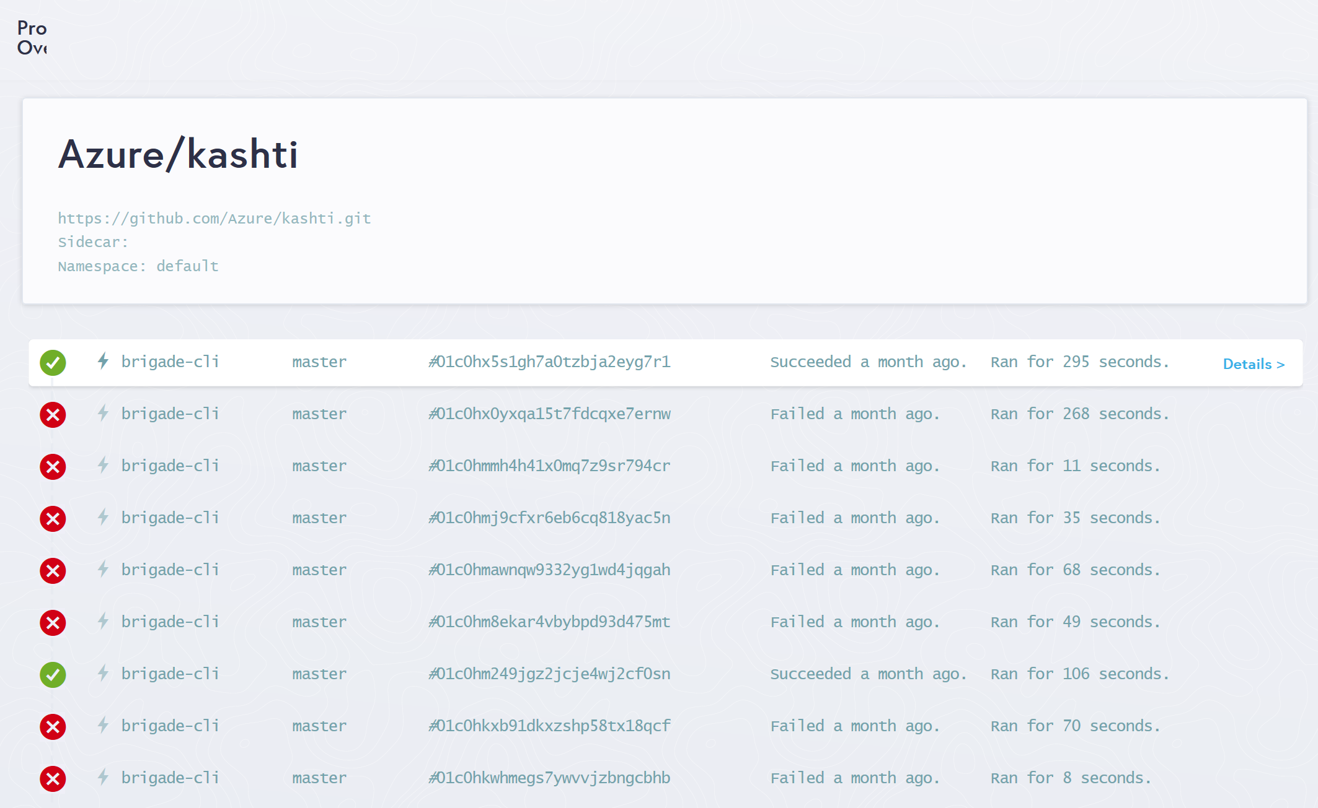
Kashti
Azure Kubernetes Service (AKS)
Dashboards for Brigade pipelines
Azure Container Instances (ACI)
Azure Container Registry
Open Service Broker API (OSBA)
Release Automation Tools
Builds dashboard
Events log

Slide 84

Questions?

Slide 85

Open source community
Azure Container Registry
Open source community
Azure Kubernetes Service (AKS)
Release automation tools
Containers 101
Getting started
Azure container technology
Open Service Broker for Azure (OSBA)
Customer success stories
Container orchestration
Azure Container Instances (ACI)

Slide 86

Community culture
Open source container code contributions
Numerous open source project builds
Open source community leadership

Slide 87
Customer success stories
Azure Container Registry
Open source community
Azure Kubernetes Service (AKS)
Release automation tools
Containers 101
Getting started
Azure container technology
Open Service Broker for Azure (OSBA)
Customer success stories
Container orchestration
Azure Container Instances (ACI)

Slide 88


Energy company electrifies pace of innovation and expansion
Ambit Energy provides electricity and natural-gas services in deregulated markets around the world. It uses technology as a competitive differentiator, employing microservices, DevOps, and continuous deployment to speed software development. To stand up infrastructure just as quickly, Ambit uses Microsoft Azure services such as Azure Container Service, together with infrastructure as code and open source technologies, to completely automate infrastructure provisioning. By implementing Azure, Ambit can move dramatically faster to enhance its services and enter new markets. Infrastructure redundancy is flexible and worry-free. And costs are 22 percent lower, which helps Ambit compete in the crowded electricity market. Because Ambit’s cloud journey is gradual, it appreciates the fact that Azure is a great hybrid-cloud enabler, connecting easily to Ambit datacenters.
Products and services
Organization size
Industry
Country
Business need
Microsoft Azure Container Service
1,000 employees
Power and utilities
United States
Optimize operational efficiency

Slide 89


Siemens Health leverages technology to connect medical devices to the cloud through AKS
Digitization and networking between healthcare providers and software development companies are essential to value-based care. Moving from the development of value-added services into becoming more of a platform provider, it became important for Siemens to adopt a microservices approach to application delivery. To that end, Siemens adopted Azure Container Service (AKS) to run their microservices-based apps. AKS puts Siemens in a position not only to deploy business logic in Docker containers—including the orchestration—but also enables them to use an applicant gateway and API management to manage exposure, control, and to meter the access continuously. With their cloud-based development approach, Siemens has driven newfound product development agility. This project is already having a positive impact within the healthcare industry.
Products and services
Organization size
Industry
Country
Business need
Microsoft Azure Container Service
100,000+ employees
Healthcare
Germany
Faster application development

Slide 90
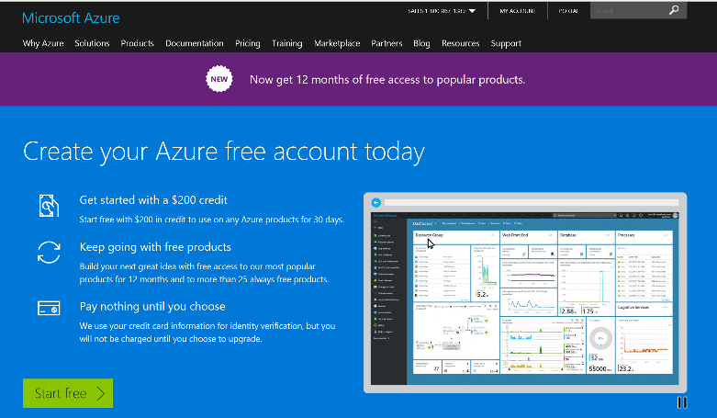
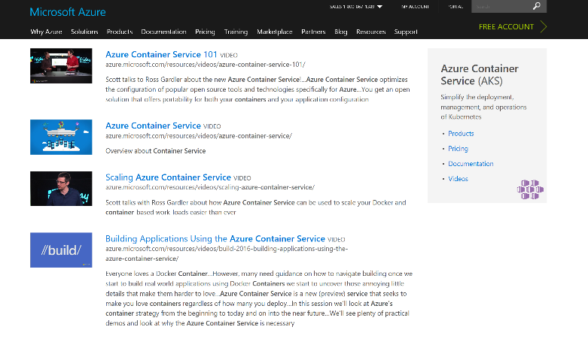
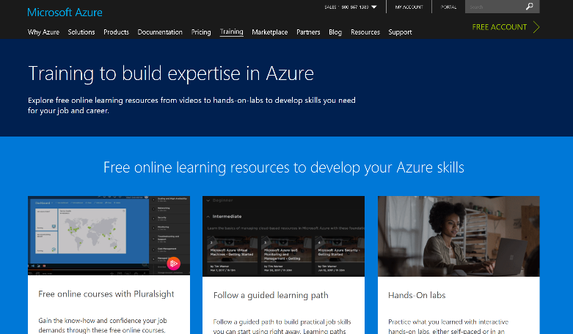
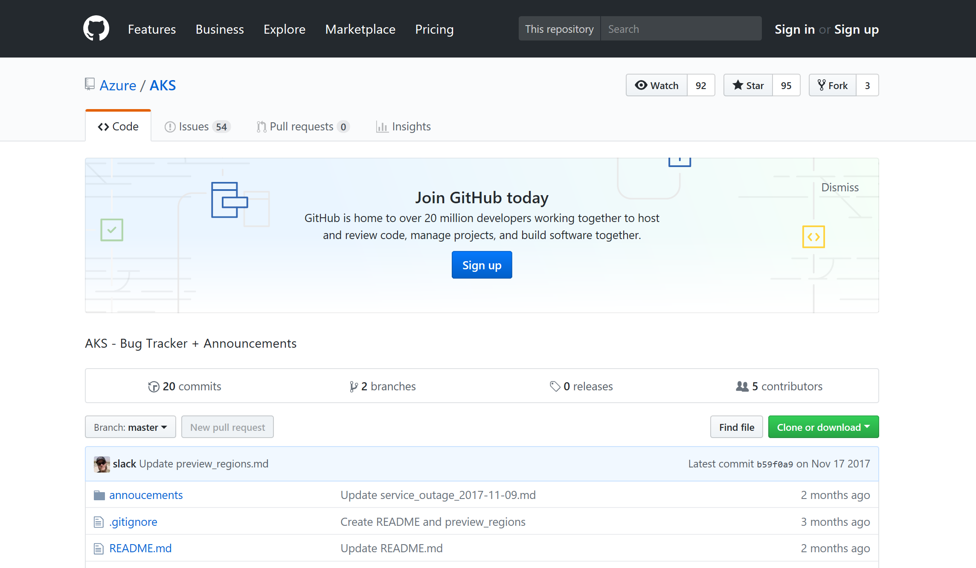
Azure container resources
Azure Kubernetes Service (AKS)
Azure Container Instances (ACI)
Azure Container Registry
OSBA announcement blog
Draft webpage
Helm webpage
Brigade webpage
Kashti announcement blog
Sign up for a free Azure account
Check out the Azure container videos page
Hone your skills with Azure training
Get the code from GitHub

Slide 91
Appendix Sections

Slide 92
So many choices…
Service | Sweet spot
Azure Web Apps | Deploy scalable web apps and services using containers
Service Fabric | Build microservice applications packaged in containers
Azure Kubernetes Service | Use OSS orchestrators to manage containers across VMs
Azure Batch | Schedule large scale batch processes deployed in containers
Azure Container Instances | Run individual containers with no VM management

Slide 93
Why Change?
Aging infrastructure
Lack of agility
High Cost
Aging hardware, operating systems, and business applications in the datacenter can impact:
Operational costs, efficiency, and reliability
Capital expenditure requirements
Security, audit, and regulatory compliance
Deployment time of new services
Operation is time (and budget) consuming
Innovation is happening outside IT inside business areas
Longer release cycles, monolithic and highly coupled architecture
Highly IT dependent
Low application performance and time-to-market compromise business agility

Slide 94

Why containers?
Repeatable execution
immutable environment
reusable and portable code (“Build, Ship, and Run”)
Consistency across development, test, & production
Fast & agile app deployment; instant startup
Cloud portability
Density, partitioning, scale
Diverse developer framework support
Promotes microservices

Slide 95
Docker, Docker, Docker
Containers have been around for many years
Linux kernel: cgroups, namespaces
Docker Inc. did not invent them
They created open source software to build and manage containers
Docker makes containers easy
Super easy. Fast learning curve
Docker is a container format and a set of tools
Docker CLI, Docker Engine, Docker Swarm, Docker Compose, Docker Machine
Notes:
Can skip the container slides based on audience level

Slide 96
What is a container?
Slice up the OS to run multiple apps on a single VM
Every container has an isolated view and gets
it’s own file system
it’s own PID0 and eth0 network interface
Container and apps share lifecycle
Shared kernel, very fast start-up, and repeatable execution
Cannot mix OS
VM/Host
Container: App-A:v1
Container: App-B:v3
Container: App-A:v2
App-A v1
App-B v3
App-A v2
Lib-L v2
Lib-L v3
Lib-L v3
Lib-M v2
Runtime v5
Runtime v7
Runtime v6

Slide 97

/lib
/src
/lib2
/config

Slide 98

Package Container
ratings-web:v1
ENV
CMD
Ports
Notes:
Slice up the OS to run multiple apps on a single VM
Every container has an isolated view and gets
it’s own file system
it’s own PID0 and eth0 network interface
Container and apps share lifecycle
Shared kernel, very fast start-up, and repeatable execution
Cannot mix OS

Slide 99
Push Container Image
App-A
Image
Repository
docker push image:tag
ENV
CMD
Ports
Notes:
Slice up the OS to run multiple apps on a single VM
Every container has an isolated view and gets
it’s own file system
it’s own PID0 and eth0 network interface
Container and apps share lifecycle
Shared kernel, very fast start-up, and repeatable execution
Cannot mix OS

Slide 100


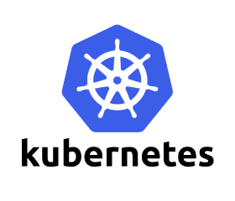


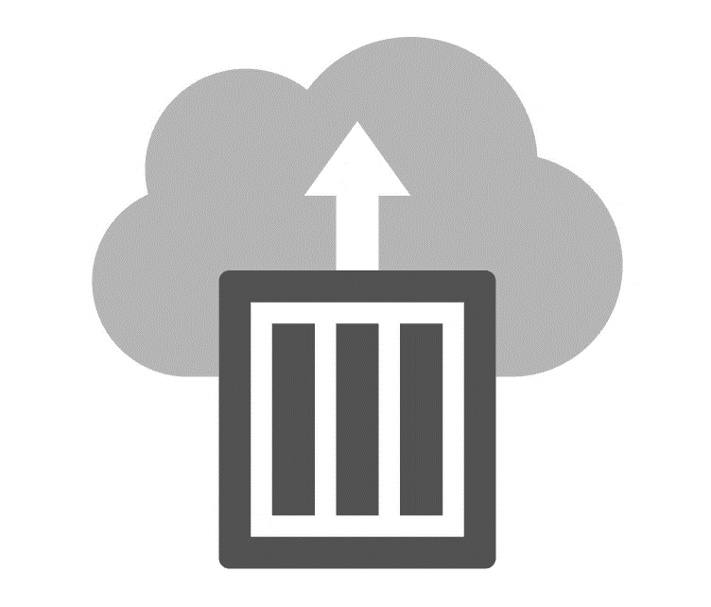
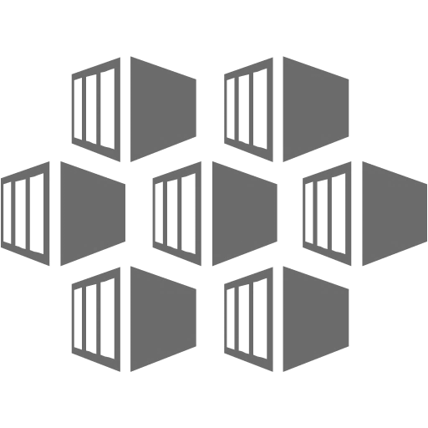
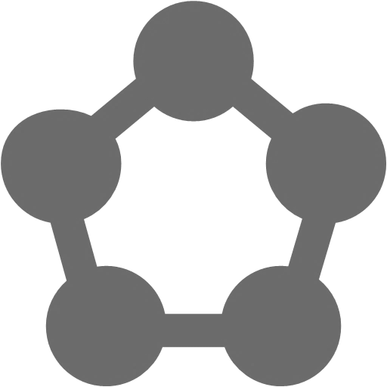


Azure Container Support
Pivotal
Cloud Foundry
Mesos DC/OS
Azure Container Instance
Azure Kubernetes Service (AKS)
Service Fabric
Web Apps
Batch
Notes:
Can you this slide or slide 25 here

Slide 101
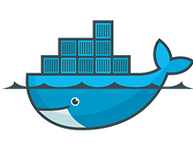



For customers with a preferred container platform Pivotal Cloud Foundry  Kubernetes  Docker Enterprise Edition Red Hat OpenShift  Mesosphere DC/OS
Azure Kubernetes Service (AKS)
Azure Container Instances (ACI)
Azure Container Registry
Open Service Broker API (OSBA)
Release Automation Tools
Help them bring that platform to Azure

Slide 102
For customers without a preferred container platform…
Azure Kubernetes Service (AKS)
Azure Container Instances (ACI)
Azure Container Registry
Open Service Broker API (OSBA)
Lead with profiling questions, then make recommendations based on the customer profiles
Release Automation Tools
For more details, refer to the container cheat sheet

Slide 103
Microservices

Slide 104
microservices ≠ containers
microservices is an architectural design approach
containers are an implementation detail that often helps

Slide 105
Microservices Benefits
Independent deployments
Enables continuous delivery
No downtime upgrades
Improved scale and resource utilization per service
Fault isolation
Security isolation
Services can be distributed across multiple servers or environments
Multiple languages / diversity
Smaller, focused teams
Code can be organized around business capabilities
Autonomous developer teams

Slide 106
Microservices – The Hard Part
Deployment is complex
Testing is difficult
Debugging is difficult
Monitoring/Logging is difficult
New service versions must support old/new API contracts
Distributed databases make transactions hard
Cluster and orchestration tools overhead
Distributed services adds more network communication
Increased network hops
Requires failure/recovery code
Need service discovery solution
Advanced DevOps capability: short-term pain for long-term gain

Slide 107
12-Factor Apps
http://12factor.net
Notes:
Explain the benefits of 12 factor apps without walking through all of them.
Recommended guidelines for good microservices apps

Slide 108
12-Factor Apps (1-5)
Single root repo; don’t share code with another app
Deploy dependent libs with app
No config in code; read from environment vars
Handle unresponsive app dependencies robustly
Strictly separate build, release, & run steps
Build: Builds a version of the code repo & gathers dependencies
Release: Combines build with config ReleaseId (immutable)
Run: Runs app in execution environment
Notes:
Single root repo; don’t share code with another app
Deploy dependent libs with app
No config in code; read from environment vars
Handle unresponsive app dependencies robustly
Strictly separate build, release, & run steps
Build: Builds a version of the code repo & gathers dependencies
Release: Combines build with config → ReleaseId (immutable)
Run: Runs app in execution environment

Slide 109
12-Factor Apps (6-12)
App executes as 1+ stateless process & shares nothing
App listens on ports; avoid using (web) host
Use processes for isolation; multiple for concurrency
Processes can crash/be killed quickly & start fast
Keep dev, staging, & prod environments similar
Log to stdout (dev=console; prod=file & archived)
Deploy & run admin tasks (scripts) as processes
Notes:
App executes as 1+ stateless process & shares nothing
App listens on ports; avoid using (web) host
Use processes for isolation; multiple for concurrency
Processes can crash/be killed quickly & start fast
Keep dev, staging, & prod environments similar
Log to stdout (dev=console; prod=file & archived)
Deploy & run admin tasks (scripts) as processes

Slide 110
ConfigMaps and Secrets
Flexible configuration model for Kubernetes
Both Secrets and ConfigMaps can be used as ENV vars or files
Secrets
Use Secrets for things which are actually secret like API keys, credentials, etc
Secret values are base64 encoded and automatically decoded for pods
ConfigMaps
ConfigMaps for configuration that doesn’t have sensitive information. However, there are pros/cons with each
ConfigMaps designed to more conveniently support working with strings
Notes:
Decouple configuration artifacts from image content to keep containerized applications portable

Slide 111
Namespaces
Allow for multiple virtual clusters backed by the same physical cluster
Logical separation
Namespace used in FQDN of Kubernetes services
Eg - <service-name>.<namespace-name>.svc.cluster.local
Every Kubernetes resource type is scoped to a namespace (except for nodes, persistentVolumes, etc.)
Intended for environments with many users, teams, projects
Notes:
Can use –all-namespaces option with kubctl if resources can’t be found
Compatible with RBAC; can lock down namespaces
Useful for clusters that have multiple teams deploying to

Slide 112
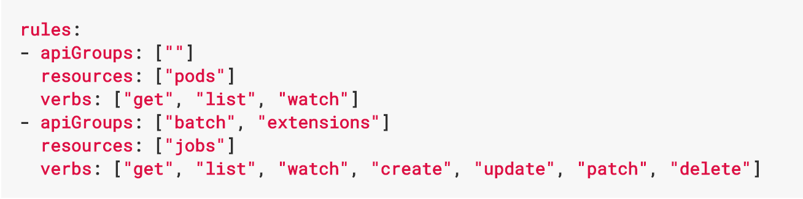
Role Based Access Control
Allows for dynamic policies against k8s API for authZ
In version 1.6, this is a beta feature
Can create both ”Roles” and “ClusterRoles”
Can configure api-server and kubectl to use Azure AD for access
To grant permissions:
Use ”RoleBindings” for within namespaces
Use “ClusterRoleBindings” for cluster-wide access
Can contain users, groups, service accounts
Control access to specific resources or API verbs

Slide 113
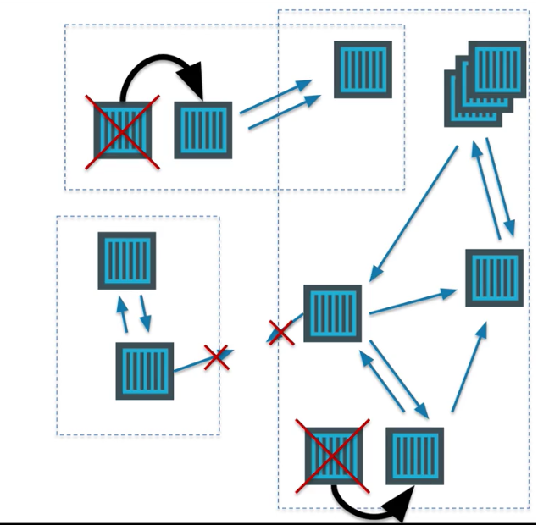
Networking in the Container World

Slide 114
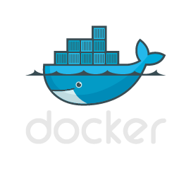


Multi-Host Networking
Agent1
Agent2
eth0 : 10.0.0.6
eth0 : 10.0.0.8
docker0 : 172.17.0.1
docker0 : 172.17.0.1
eth0 : 172.17.0.3
eth0 : 172.17.0.3
eth0 : 172.17.0.4
eth0 : 172.17.0.4
vethxxx
vethxxx
vethxxx
vethxxx

Slide 115




Multi-Host Networking
Agent1
key/value
store
Agent2
eth0 : 10.0.0.6
eth0 : 10.0.0.8
docker0 : 172.17.0.1
docker0 : 172.17.0.1
192.168.0.0/24
eth0 : 192.168.0.1
eth0 : 192.168.0.3
eth0 : 192.168.0.2
eth0 : 192.168.0.4
vethxxx
vethxxx
vethxxx
vethxxx

Slide 116
What is service discovery?
Problem: How service can find and communicate with another one running into the same cluster?
Service Registry/Naming Service
Service Announcement
Lookup/Discovery
Load Balancing
?!?

Slide 117

Networking in Kubernetes
Kubernetes Networking model introduces 3 methods of communications:
Pod-to-Pod communication directly by IP address. Kubernetes has a Pod-IP wide metric simplifying communication.
Pod-to-Service Communication – Client traffic is directed to service virtual IP by iptables rules that are modified by the kub-proxy process (running on all hosts) and directed to the correct Pod.
External-to-Internal Communication – external access is captured by an external load balancer which targets nodes in a cluster. The Pod-to-Service flow stays the same.
Notes:
When the backend Service is created, the Kubernetes master assigns a virtual IP address, for example 10.0.0.1. Assuming the Service port is 1234, the Service is observed by all of the kube-proxy instances in the cluster. When a proxy sees a new Service, it installs a series of iptables rules which redirect from the VIP to per-Service rules. The per-Service rules link to per-Endpoint rules which redirect (Destination NAT) to the backends.
When a client connects to the VIP the iptables rule kicks in. A backend is chosen (either based on session affinity or randomly) and packets are redirected to the backend. Unlike the userspace proxy, packets are never copied to userspace, the kube-proxy does not have to be running for the VIP to work, and the client IP is not altered.
This same basic flow executes when traffic comes in through a node-port or through a load-balancer, though in those cases the client IP does get altered.

Slide 118

Service Discovery with Kubernetes
Nodes, Deployments, Pods, Services
Services
Expose the services
Works with platform Load Balancers to get public IPs
Internal load balancing between pods
kube-dns (preferred)
Name service enabled in Kubernetes (Default in ACS)
Environment Variables
Every Service is assigned environment variables with information of the service
REDIS_MASTER_SERVICE_HOST=10.0.0.11 REDIS_MASTER_SERVICE_PORT=6379 REDIS_MASTER_PORT=tcp://10.0.0.11:6379 REDIS_MASTER_PORT_6379_TCP=tcp://10.0.0.11:6379 REDIS_MASTER_PORT_6379_TCP_PROTO=tcp REDIS_MASTER_PORT_6379_TCP_PORT=6379 REDIS_MASTER_PORT_6379_TCP_ADDR=10.0.0.11
Source: https://kubernetes.io/docs/tutorials/kubernetes-basics/expose-intro/
Notes:
NOTE ON ENVIRONMENT VARIABLES: This does imply an ordering requirement - any Service that a Pod wants to access must be created before the Pod itself, or else the environment variables will not be populated. DNS does not have this restriction.

Slide 119
Ingresses
Typically, services and pods have IPs only routable by the cluster network
All traffic that ends up at an edge router is either dropped or forwarded elsewhere
Ingress is a collection of rules that allow inbound connections to reach the cluster services
An Ingress controller is responsible for fulfilling the Ingress, usually with a loadbalancer, though it may also configure your edge router or additional frontends to help handle the traffic in an HA manner
Notes:
I
Pods won’t survive scheduling failures, node failures, or other evictions, such as due to lack of resources, or in the case of node maintenance.

Slide 120
Container Network Interface (CNI)
CNI (a CNCF project) is a spec for plugins to configure Linux container network interfaces
Wide range of support
Kubernetes, OpenShift, Cloud Foundry, Mesos, rkt, etc.
Examples
Calico, Weave, Contiv, etc.
Azure CNI plug-in integrates Azure VNET into kubernetes clusters
Use acs-engine
Notes:
CNCF = Cloud Native Computing Foundation
https://github.com/Azure/azure-container-networking/blob/master/docs/acs.md

Slide 121
Daemonsets
Ensures that all (or some) nodes run a copy of a pod
Doesn't care if a node is marked as unschedulable
Can make pods even if the scheduler is not running

Slide 122
StatefulSets
Used for workloads that require consistent, persistent hostnames e.g. etcd-01, etcd-02
One PersistentVolume storage per pod
StatefulSet example - zookeeper
StatefulSet example - cockroachdb
Notes:
Manages the deployment and scaling of a set of Pods, and provides guarantees about the ordering and uniqueness of these Pods.
StatefulSets are valuable for applications that require one or more of the following.
Stable, unique network identifiers.
Stable, persistent storage.
Ordered, graceful deployment and scaling.
Ordered, graceful deletion and termination.
Ordered, automated rolling updates.

Slide 123
Jobs
Creates one or more pods and ensures that a specified number of them successfully terminate
3 types of jobs
Non-parallel Jobs - e.g. single pod done when exit is successful
Parallel Jobs with a fixed completion count - e.g. one successful pod for each value in the range 1 to .spec.completions
Parallel Jobs with a work queue that coordinate with each other and terminate when one pod exits successfully

